Slide 1
E-CLASSROOM
VHORA YASIN 3038
LATA VIRALKUMAR 3025

Slide 2
WHAT IS E-CLASSROOM?
This project IS ONE KIND OF E-EDUCATION WHICH CONTAIN MANY TYPES OF E-LEARNING FACILITIES WITH PROBLEM SOLVING,ONLINE COURSE,GROUP DISCUSSION SYSTEM, SUBJECT EXPERTS. BY WHICH USER(STUDENT) CAN EASILY LEARN ANY PERTICULAR TOPIC AND CAN ALSO CHECK HIS/HER PROGRESS IN PERTICULAR TOPIC.
.

Slide 3
CURRENT SYSTEM
UNACADEMY :-https://unacademy.com/
GRADEUP :- https://gradeup.co/
BYJU`S:-https://byjus.com/
Udemy:- https://www.udemy.com/

Slide 4
DRAWBACKS OF CURRENT SYSTEM
DO NOT GIVE THE FACILITIES TO STUDENT TO DO COMMUNICATION
WITH EACHOTHER.
IN THIS SYSTEM THEY DID NOT PROVIDE US FACILITY OF SOLVING THE
PROBLEM OF STUDENTS.
IN CURRENT SYSTEM STUDENT DO NOT CHECK THEIR
PROGRESS.

Slide 5
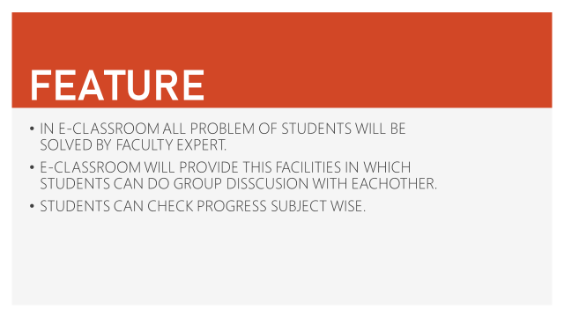

Slide 6
USERS
ADMIN
SUBJECT EXPERT
STUDENT

Slide 7
DETAILS & SERVICE EXPLANATION OF MODULES
ADMIN
Admin login.
Maintaining the website.
Make sure that student will get their information and material time to time.
Make sure that every faculty solve the problems of students and submit it on time to time.

Slide 8
DETAILS & SERVICE EXPLANATION OF MODULES
STUDENTS
Registration/login.
Will select the course to study.
Can give online exam
Can take material to study.
Can do group discussions.
Feed back.

Slide 9
DETAILS & SERVICE EXPLANATION OF MODULES
SUBJECT EXPERT
Faculty login
To solve the problems of students.
To give the material and important for exam.
To create question papers(practice paper)for online examination.
Group Discussion.

Slide 10
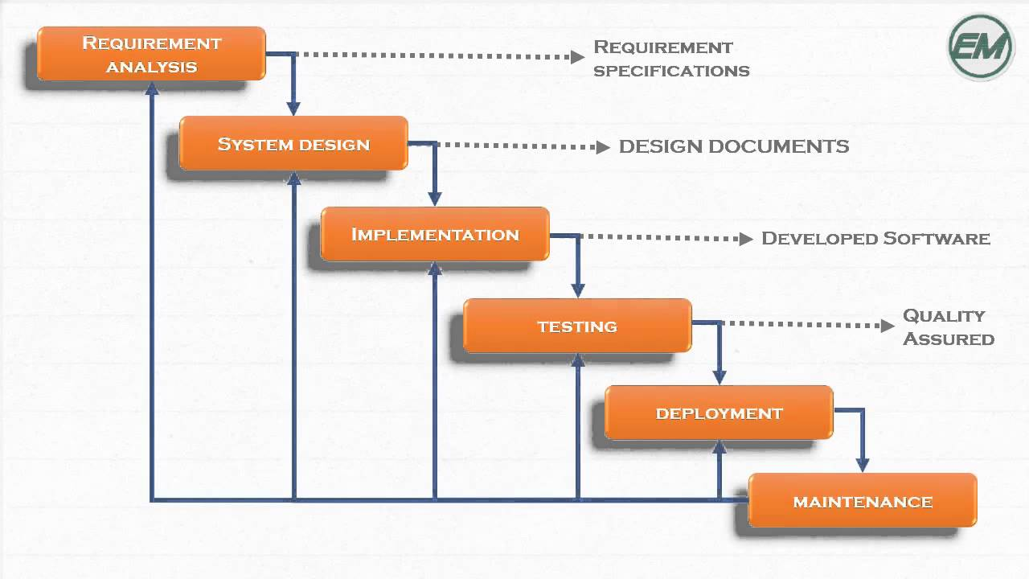
Representation of WATERFALL MODEL:-
We are choosing WATERFALL MODEL
in our website.

Slide 11
Why we use Waterfall model?
We are choosing waterfall model, because in our system requirement are clear and well understood.
Our functionalities are not going to be changed in long-term future as we are not adding any other module.
It’s simple approach as it requires documentation at end of each phase and it’s very useful for us to verify it.
Our system is an intermediate between the student and Subject experts so our services are clear.

Slide 12
SYSTEM
FLOW
DIAGRAM

Slide 13
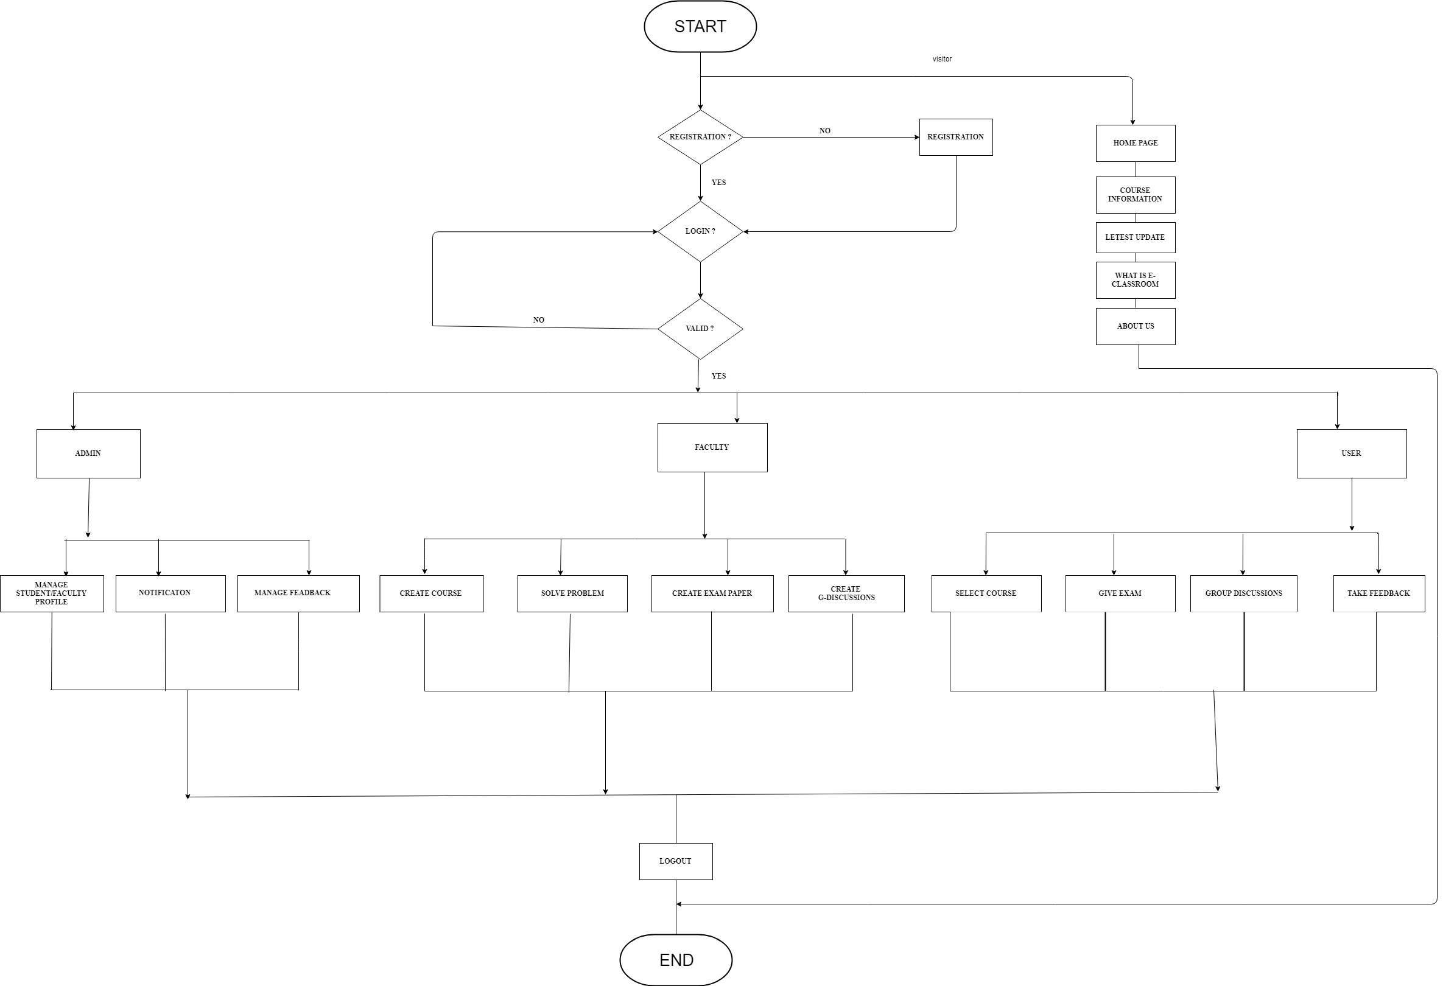

Slide 14
DATA
FLOW
DIAGRAM

Slide 15
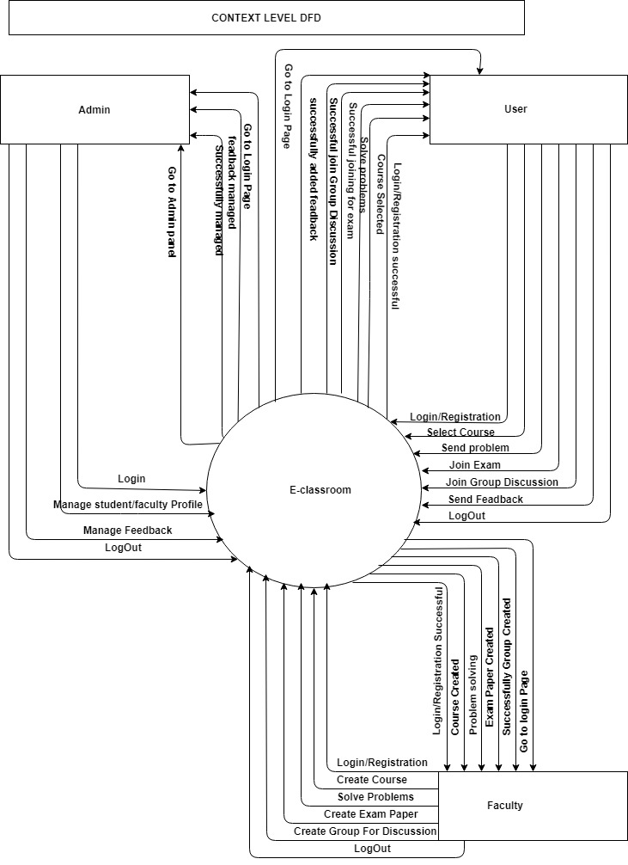
Context Level of DFD

Slide 16
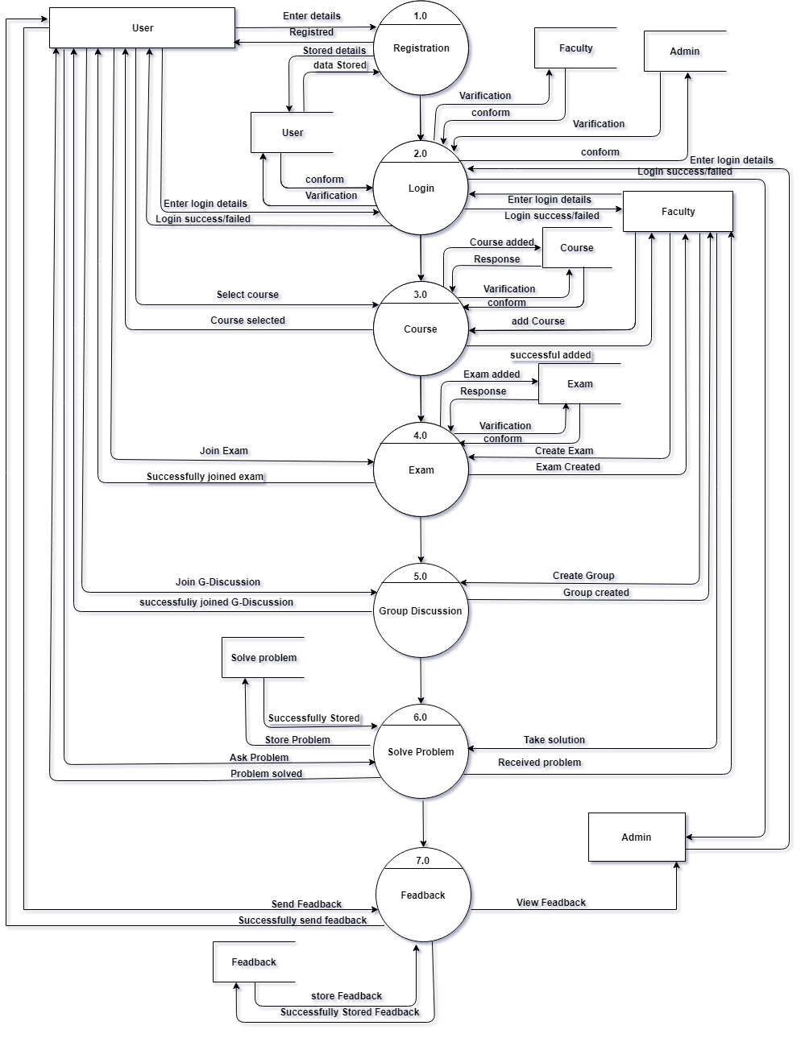
First Level DFD

Slide 17
ER-Diagram

Slide 18
DATA DICTIONARY

Slide 19
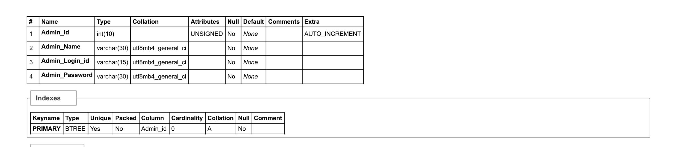
Admin_table

Slide 20
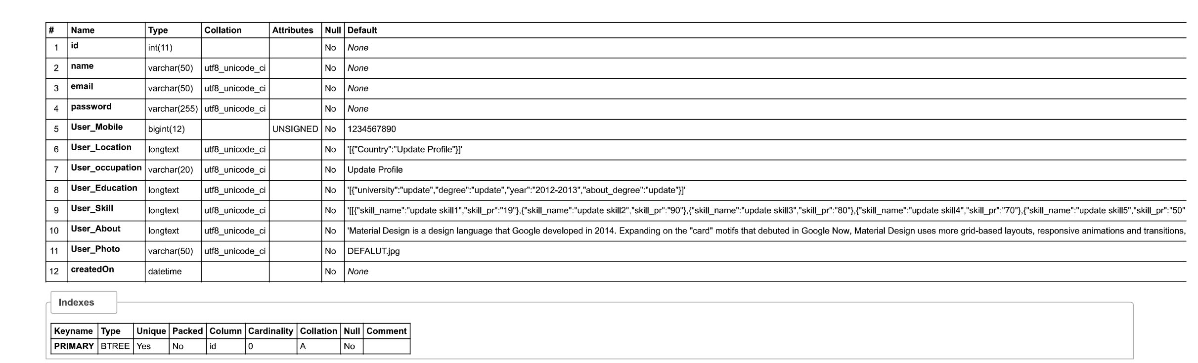
User_table

Slide 21
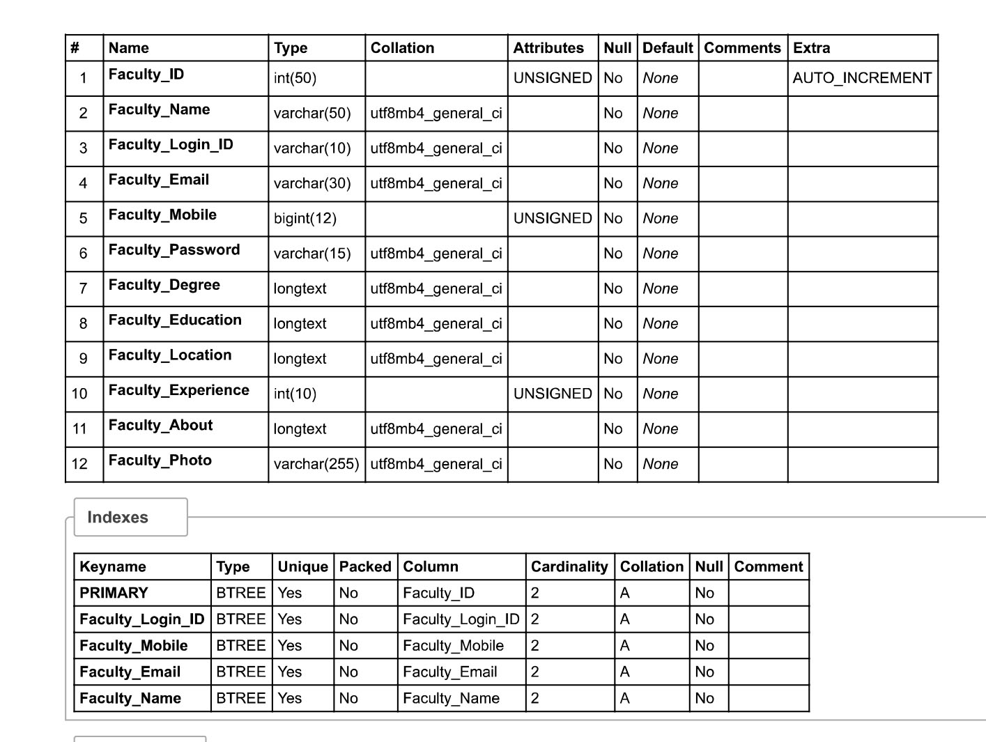
Feculty_table

Slide 22
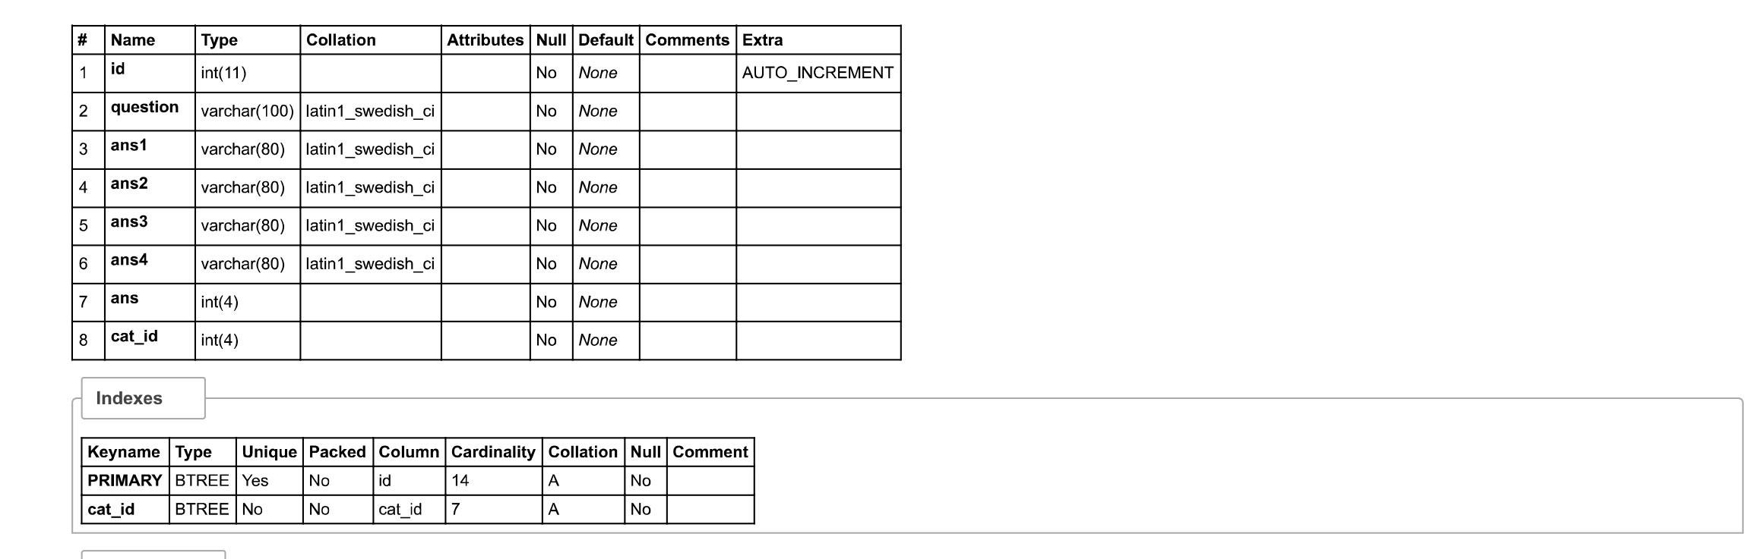
ExamQuiz_table

Slide 23
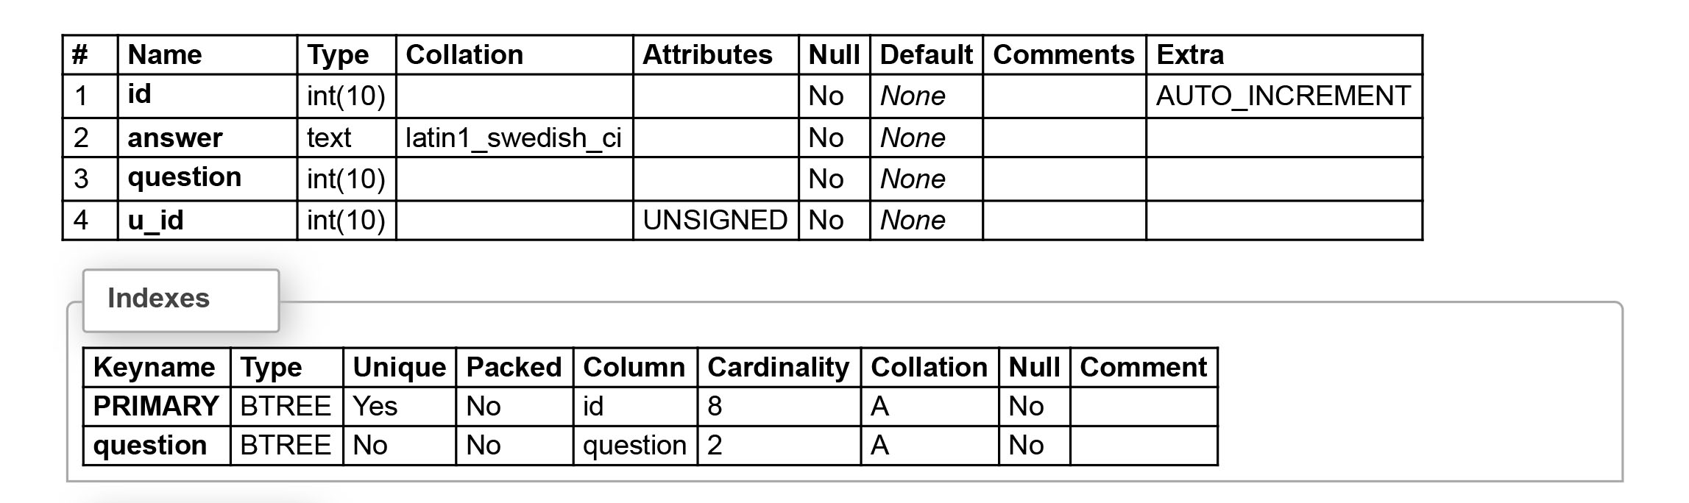
Problem solve table

Slide 24
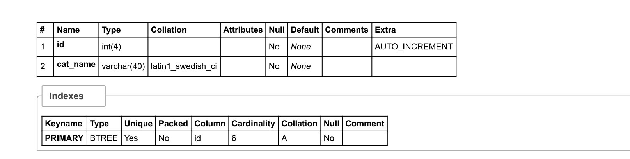
Exam_category

Slide 25
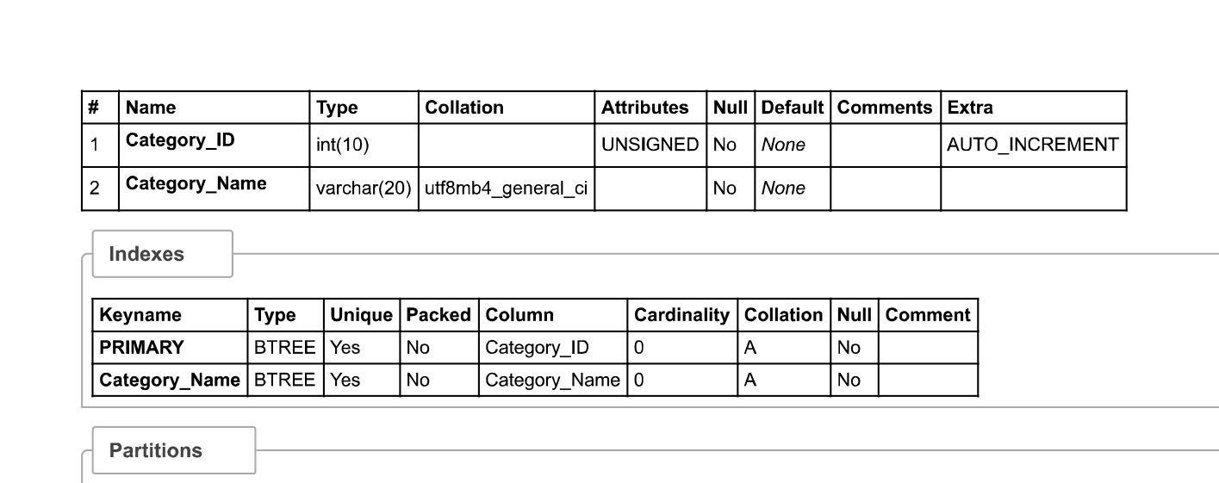
Course_category_table

Slide 26
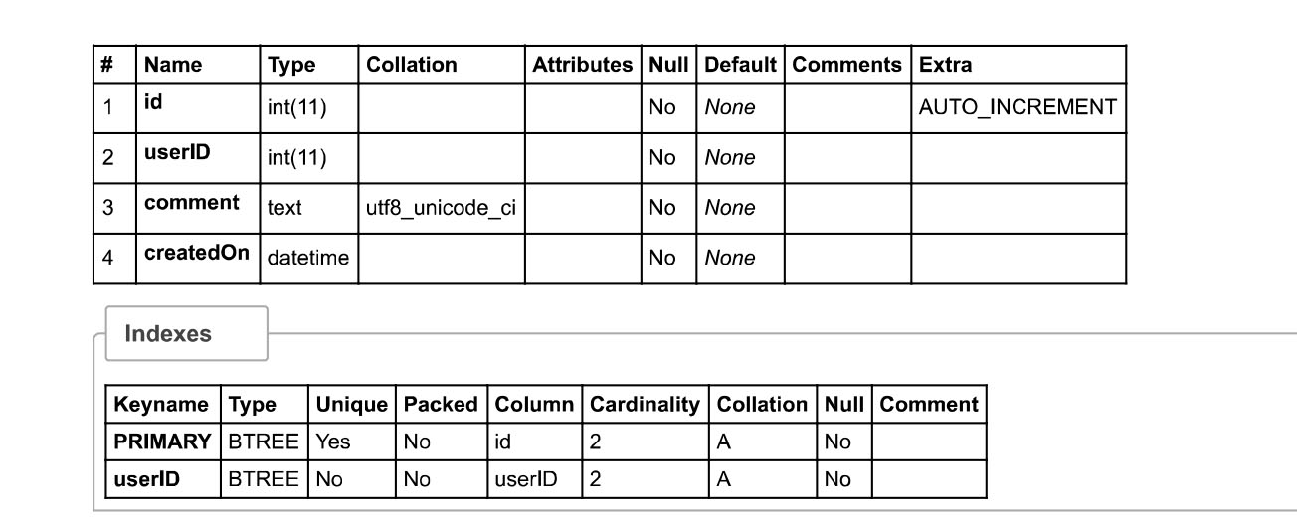
Comment_table

Slide 27
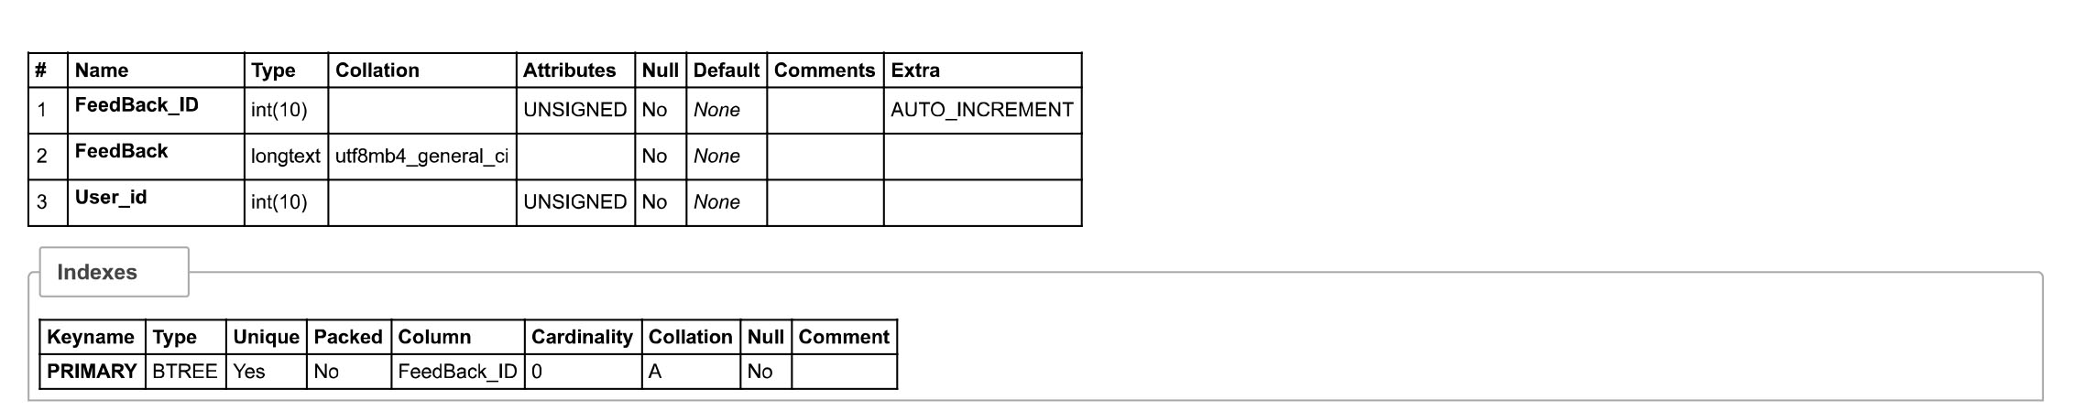
Feedback_table

Slide 28
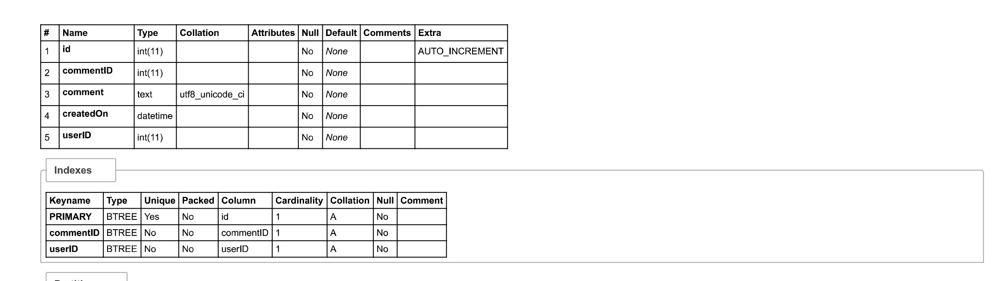
Replies_table

Slide 29


Slide 30
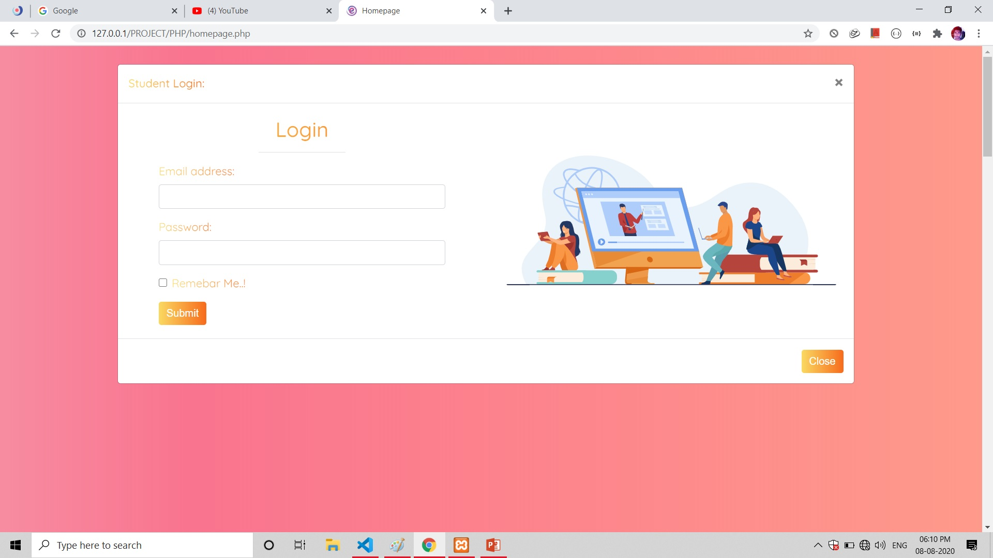

Slide 31
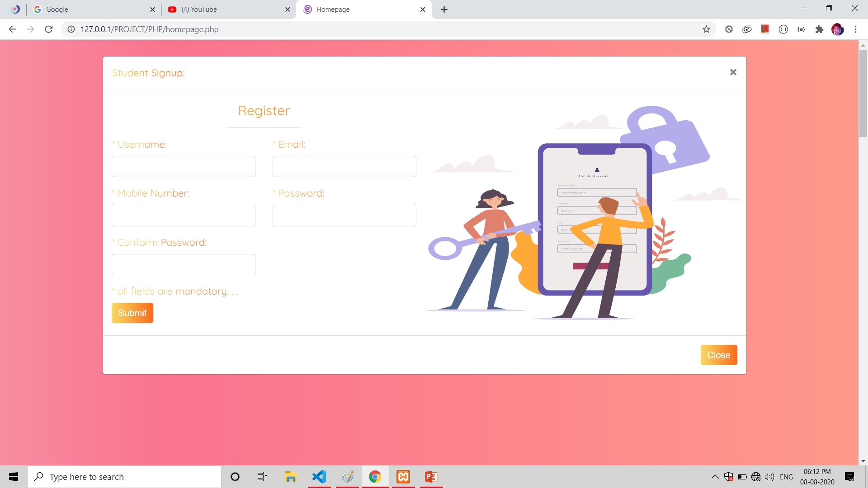

Slide 32
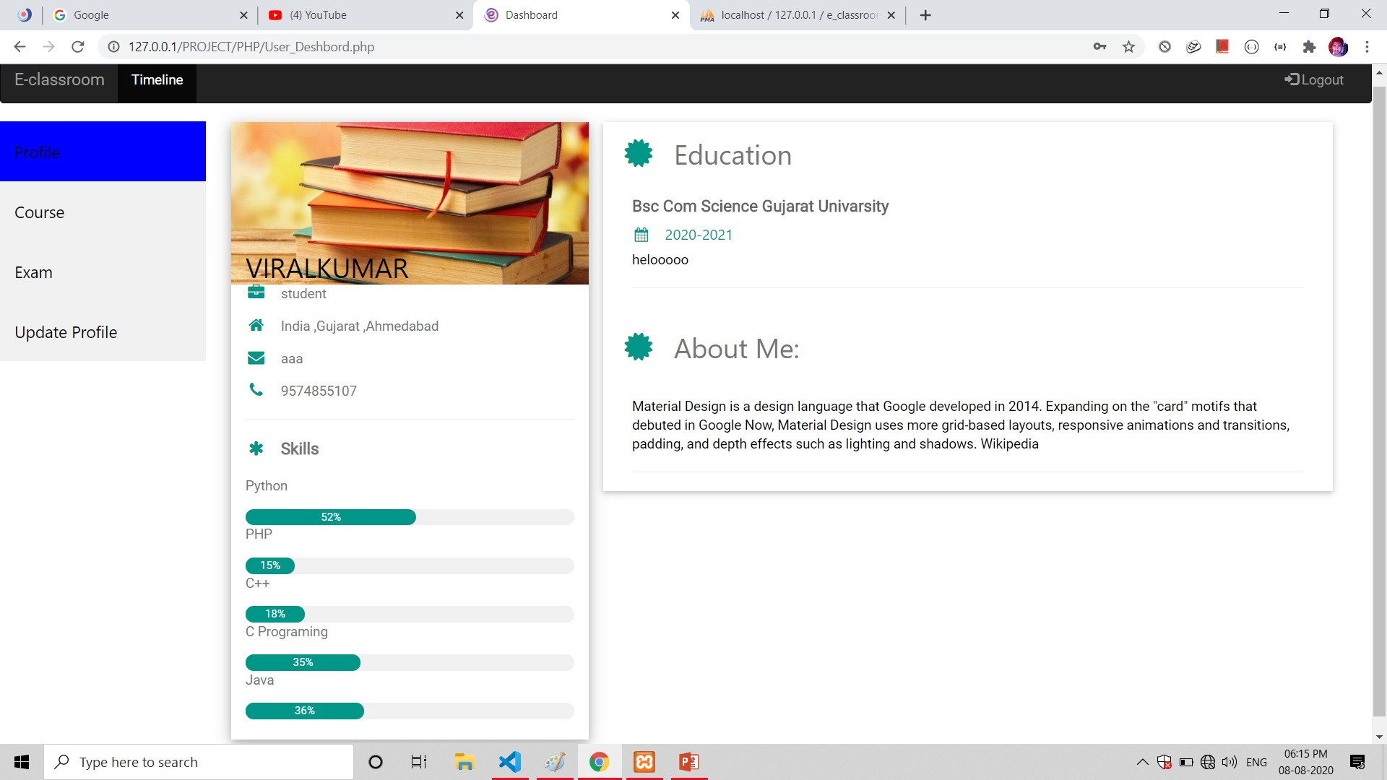

Slide 33
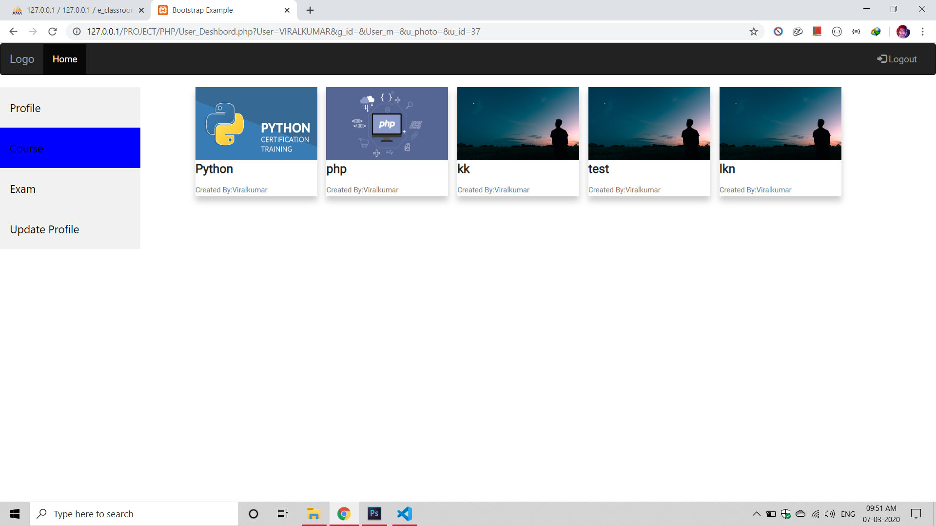

Slide 34
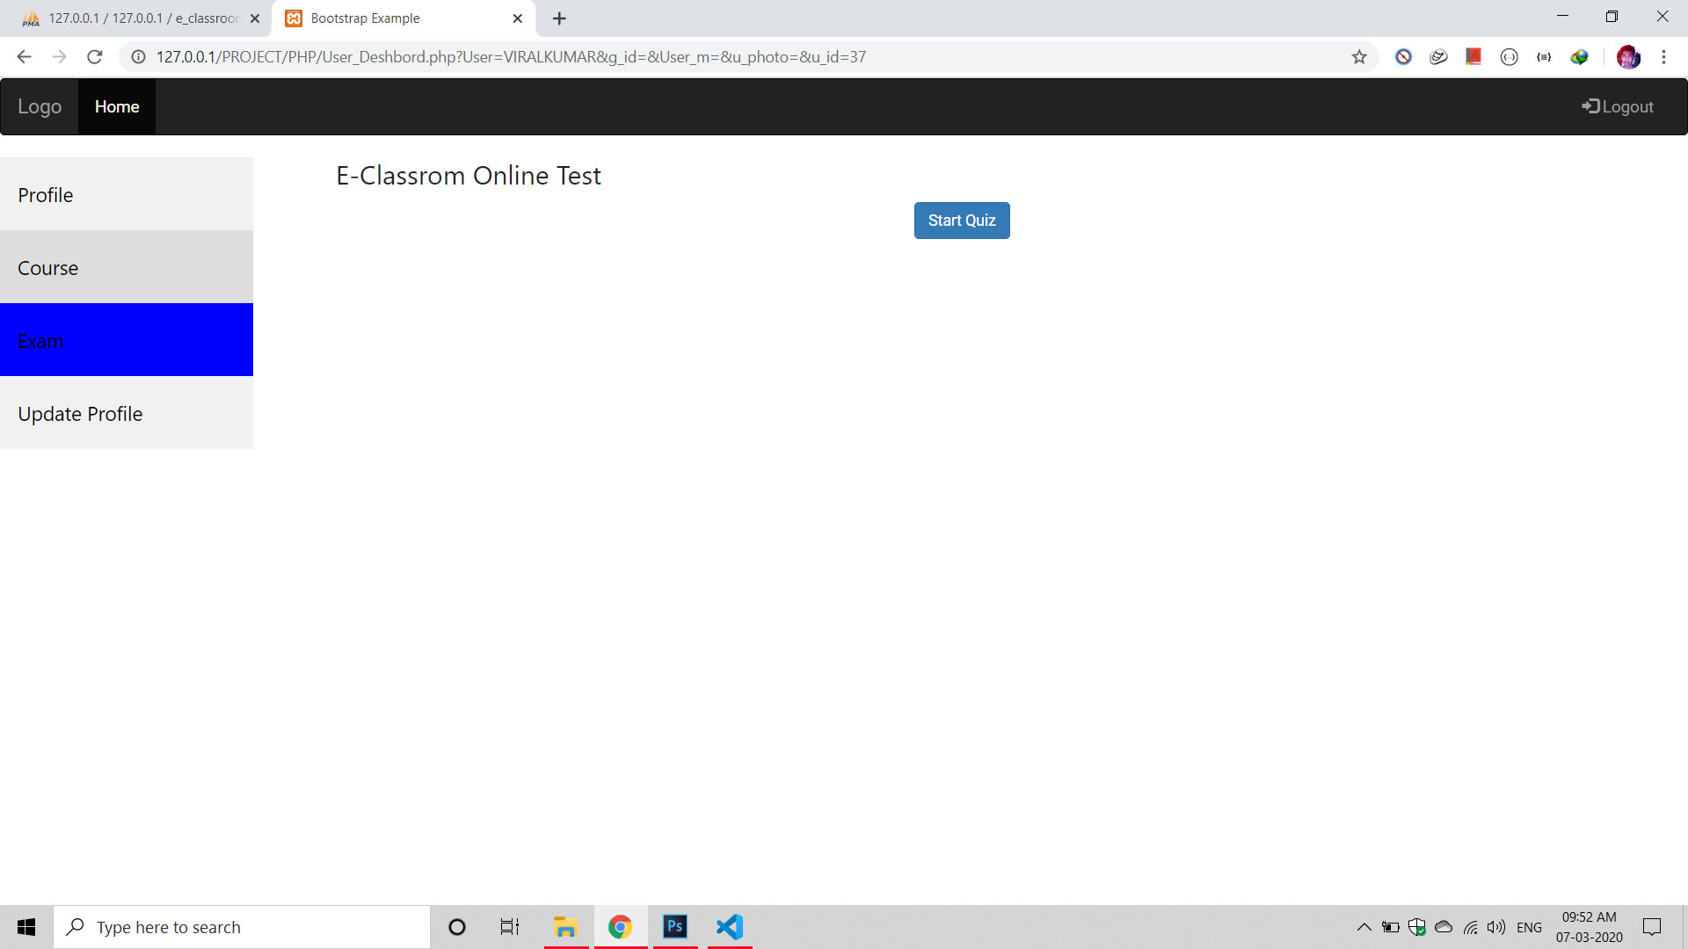

Slide 35
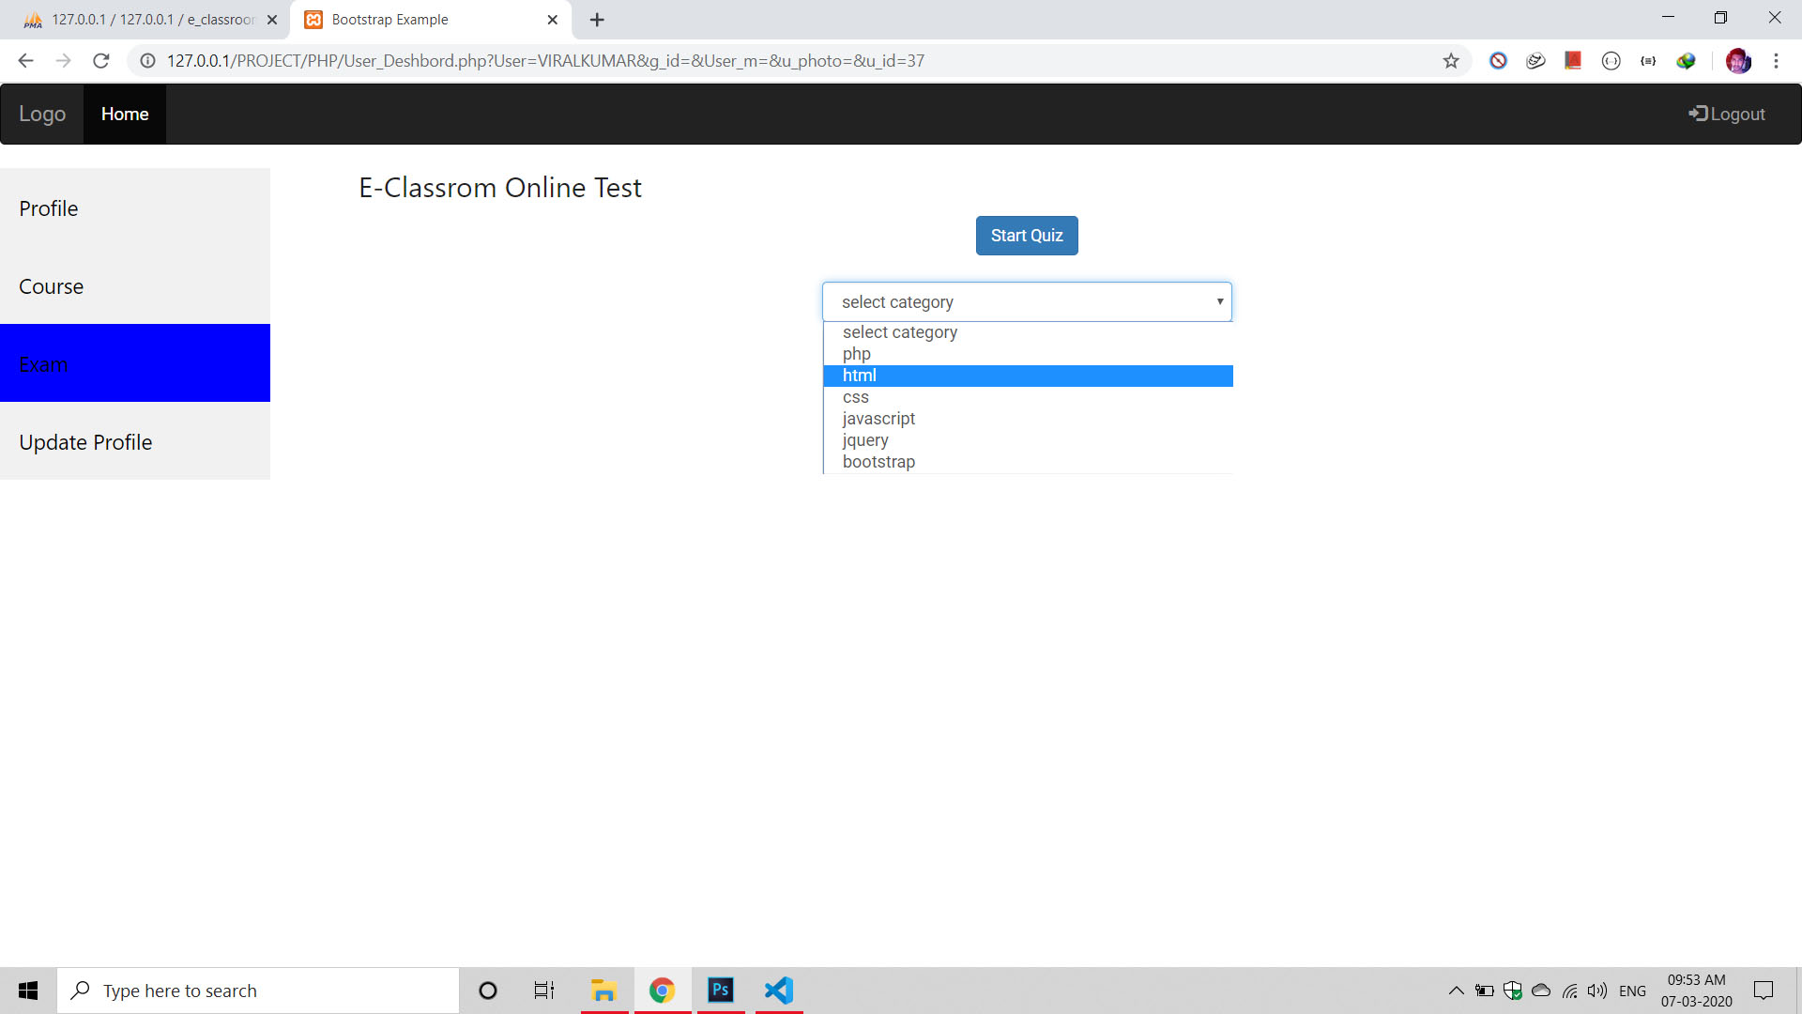

Slide 36
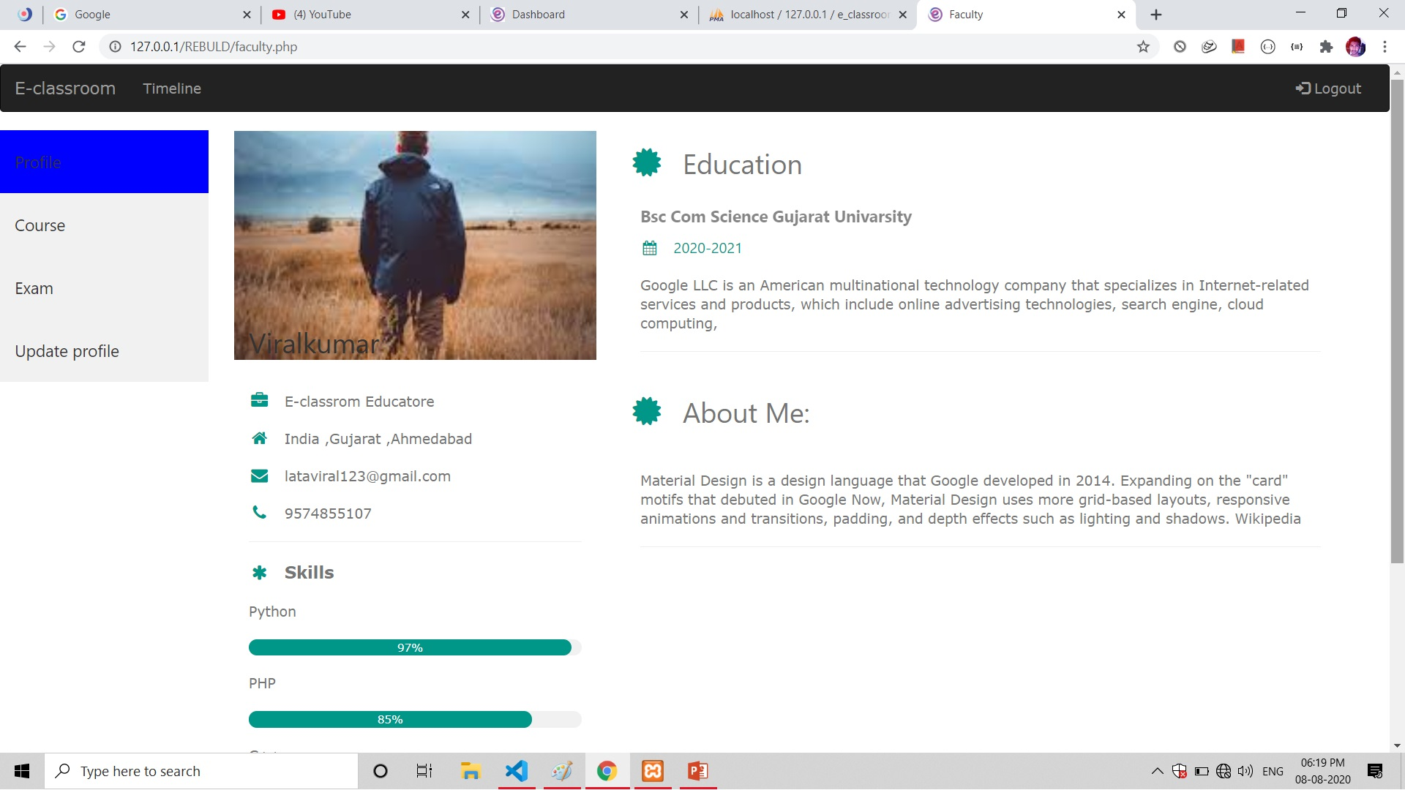

Slide 37
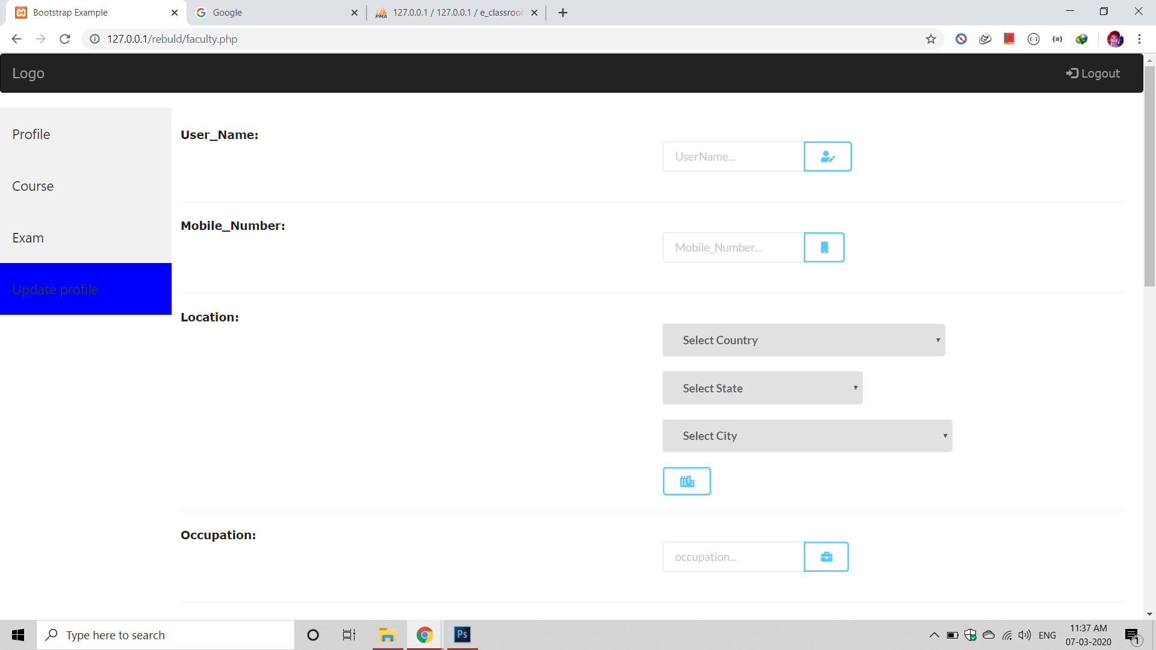

Slide 38
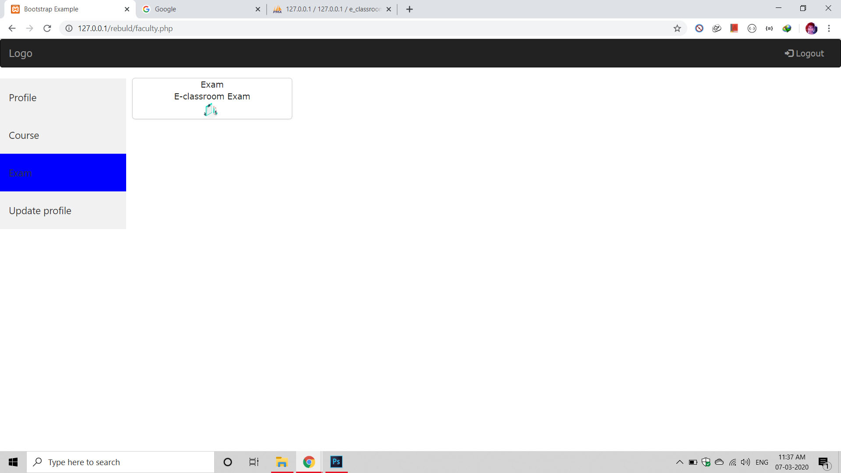

Slide 39
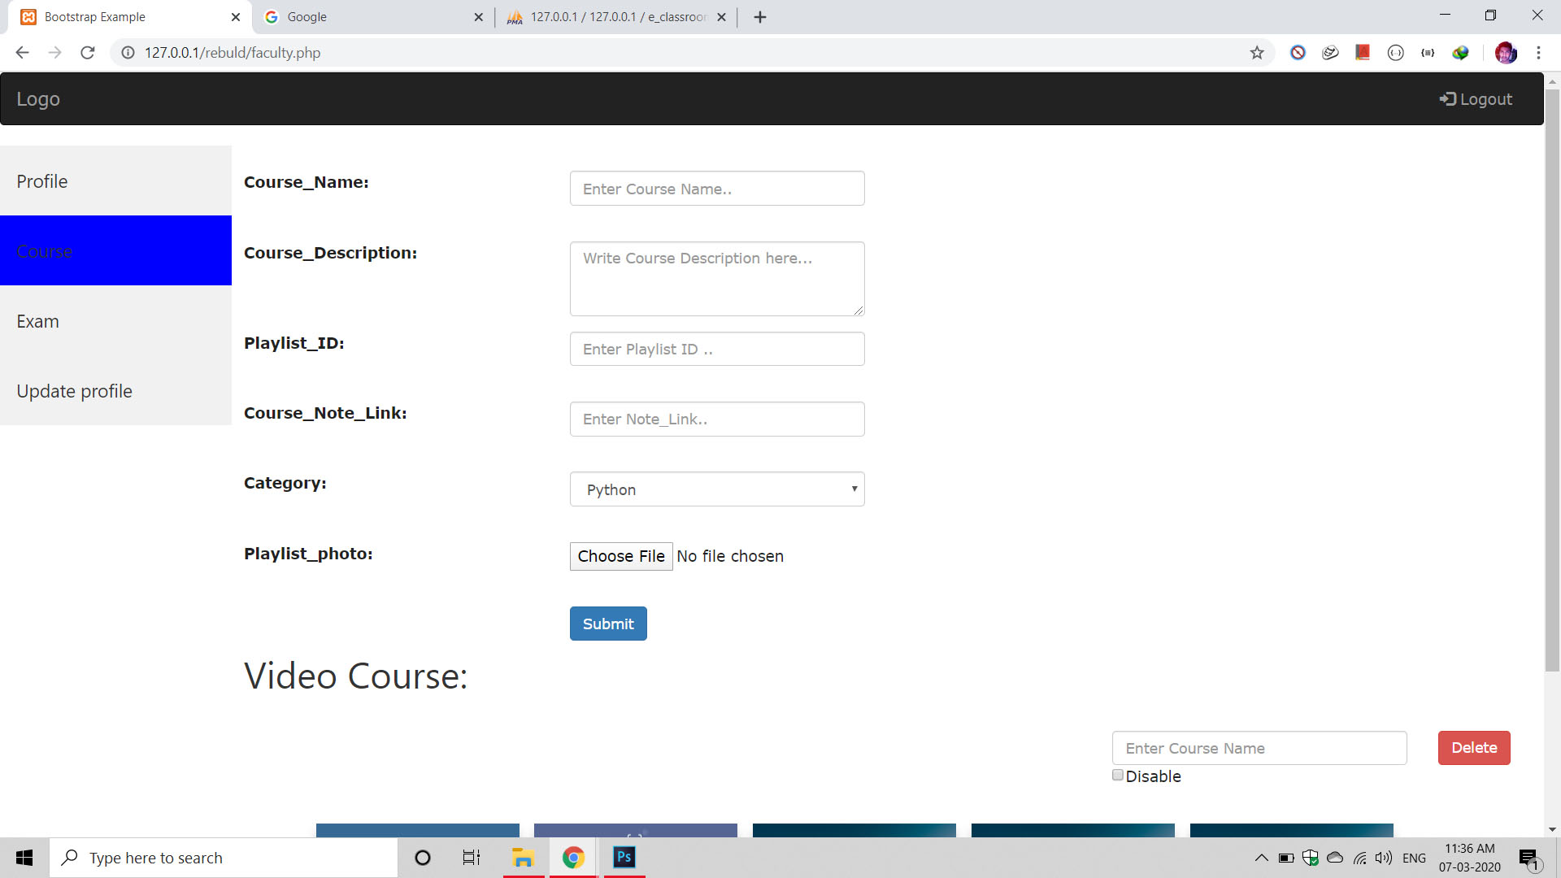

Slide 40


Slide 41
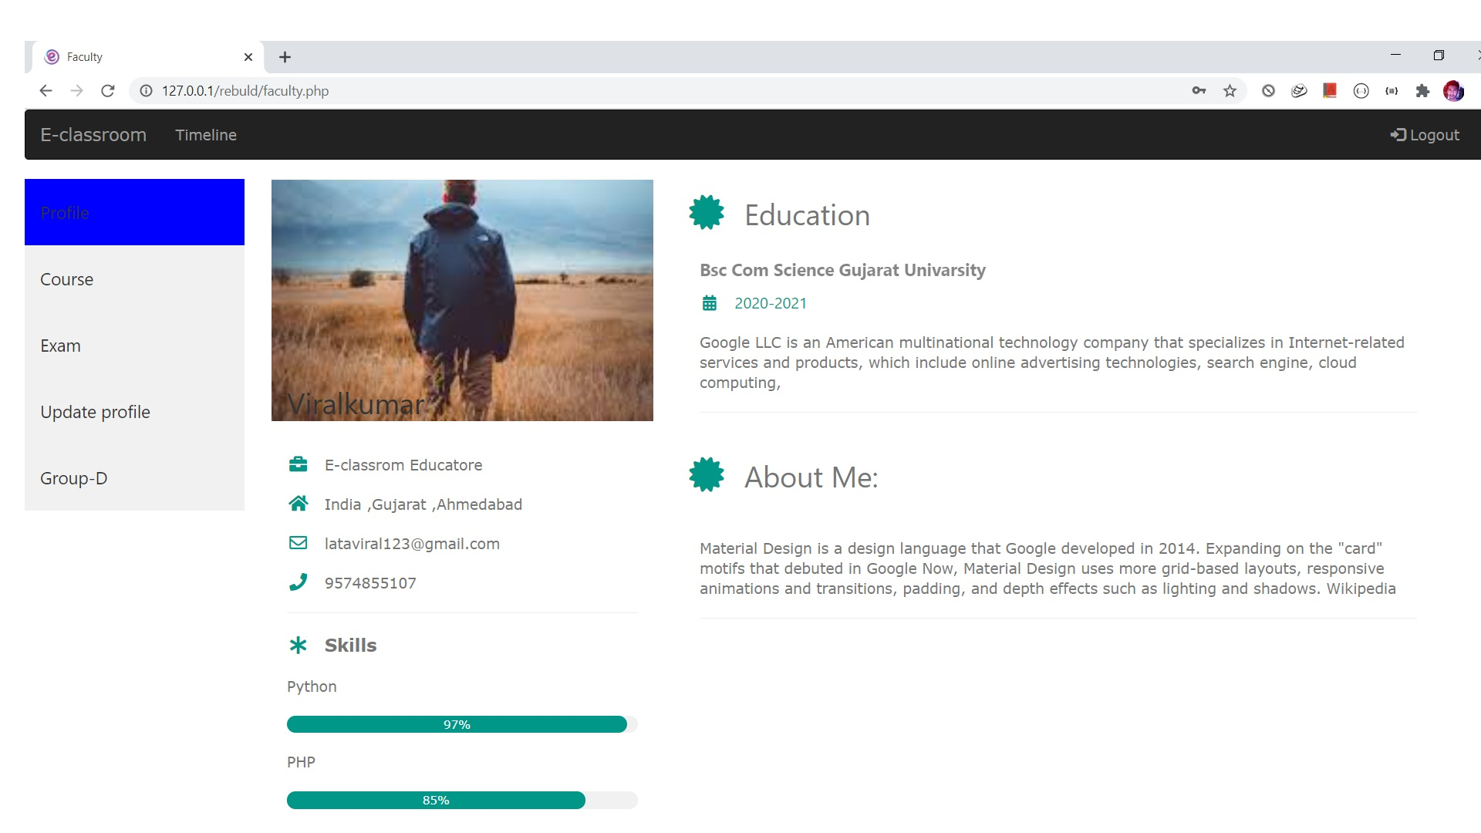

Slide 42
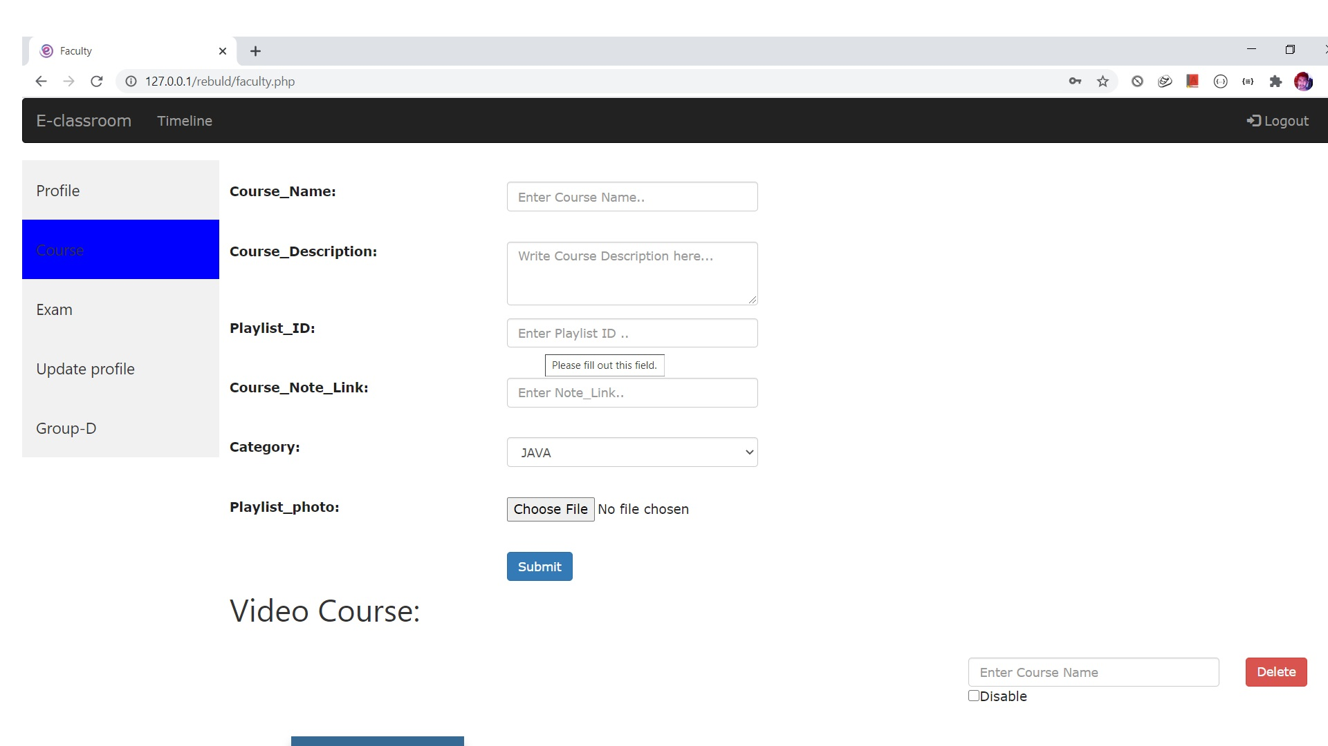

Slide 43
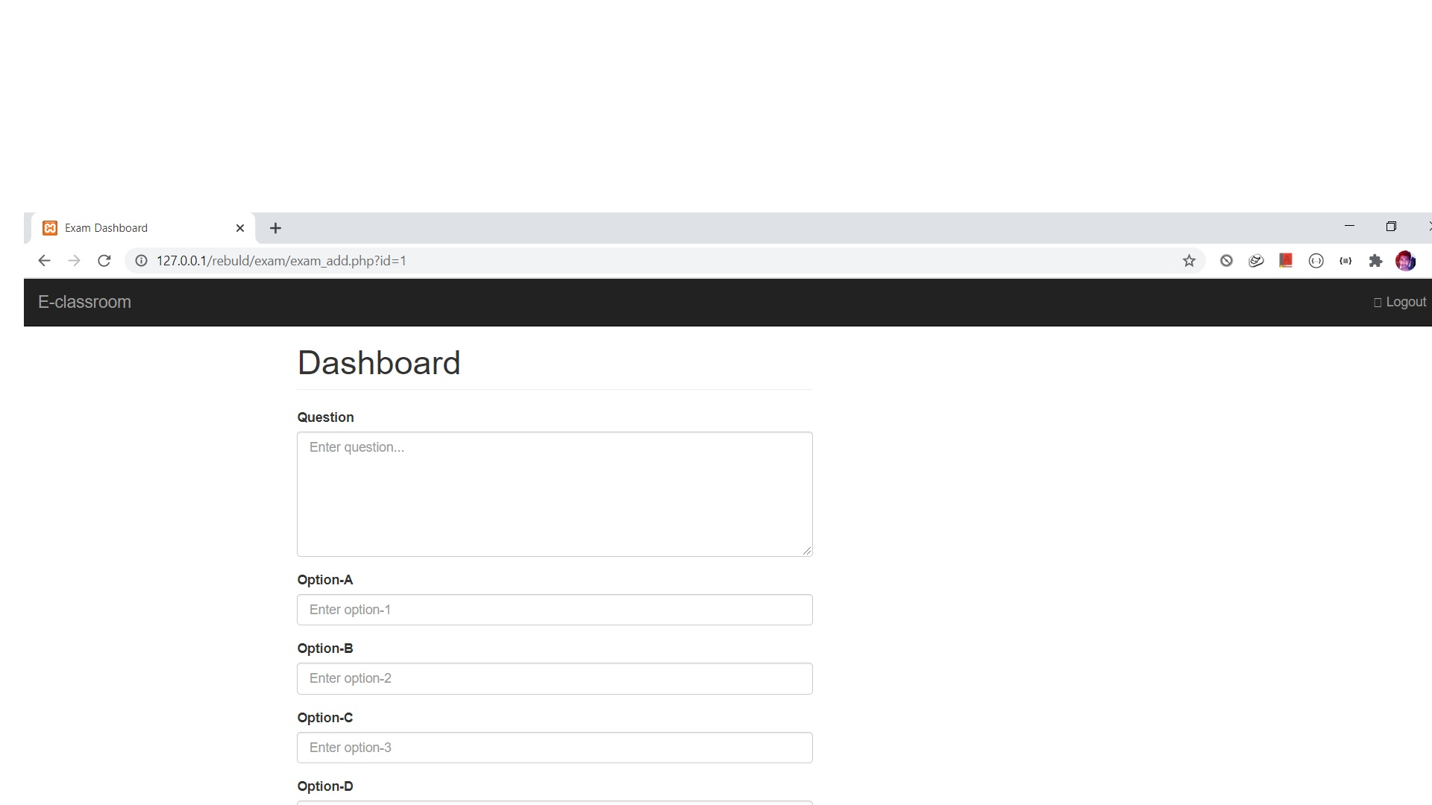

Slide 44
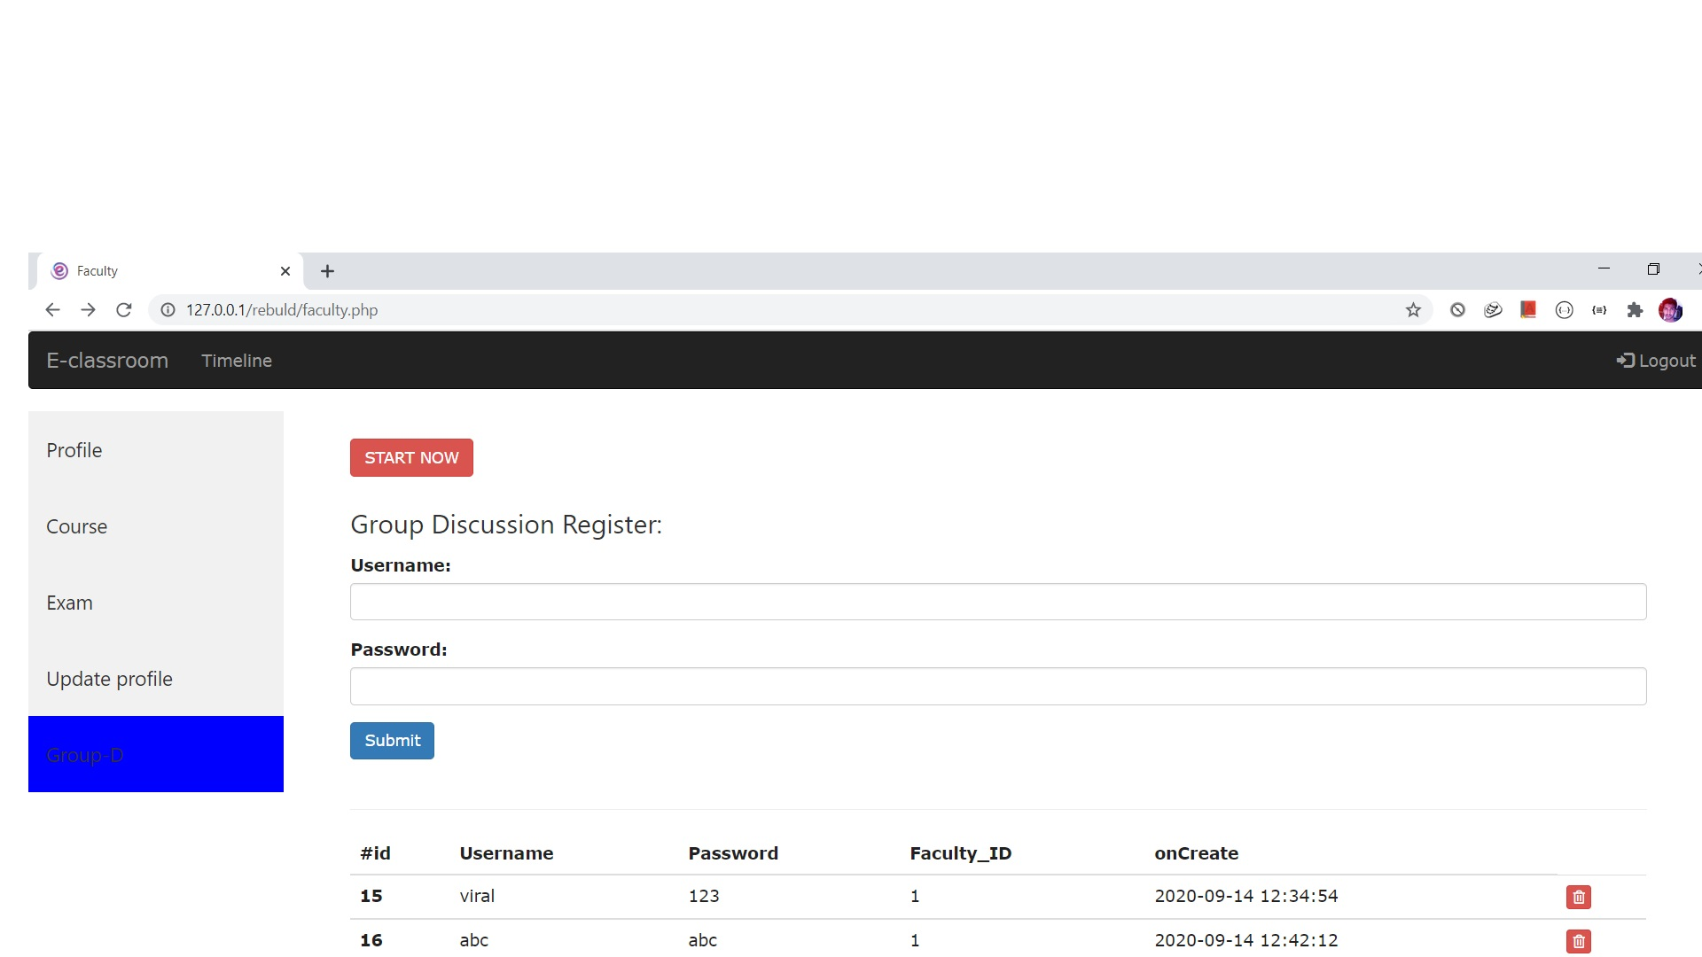

Slide 45
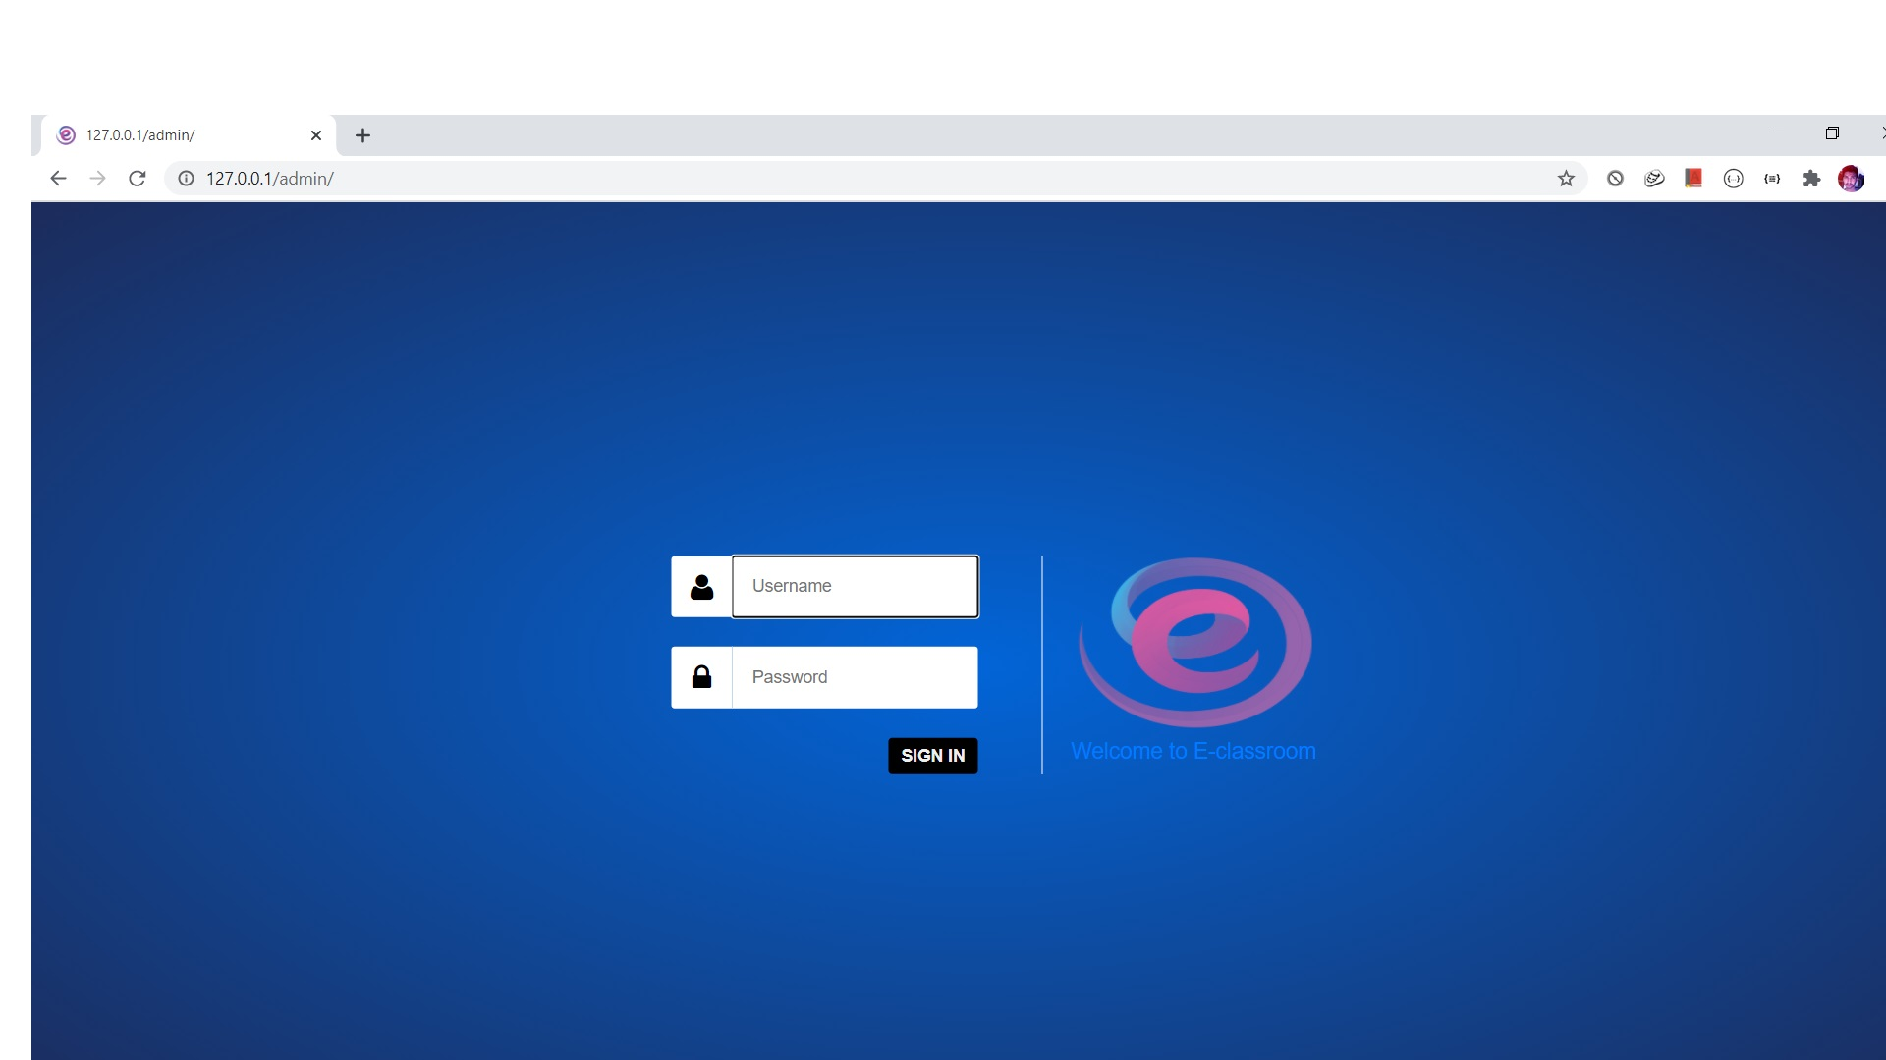

Slide 46
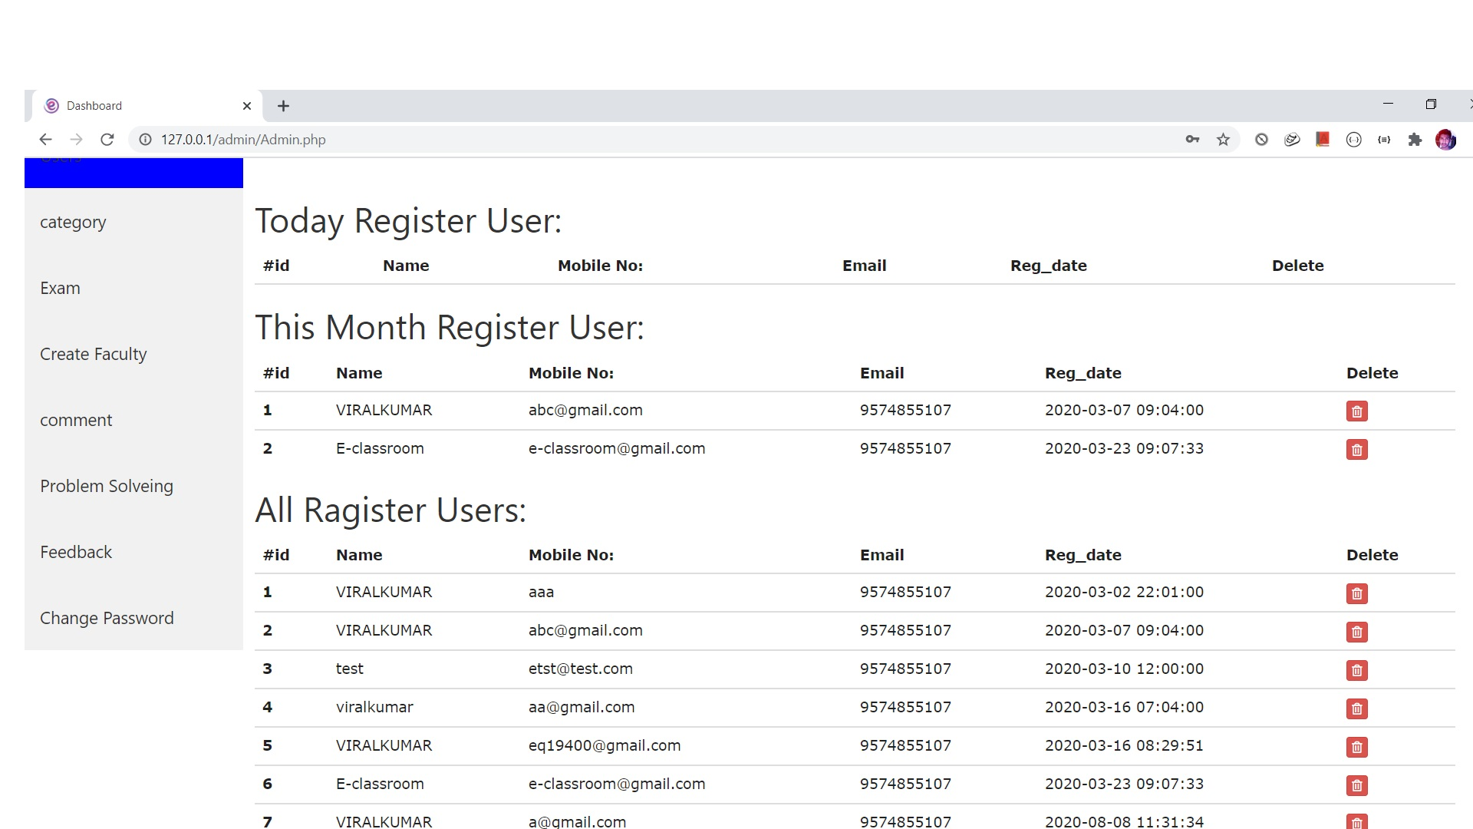

Slide 48
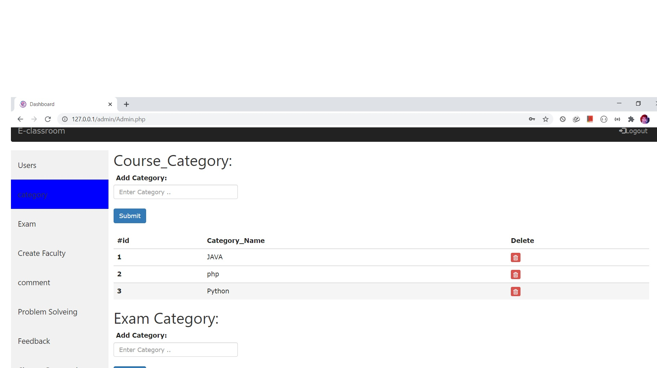

Slide 49
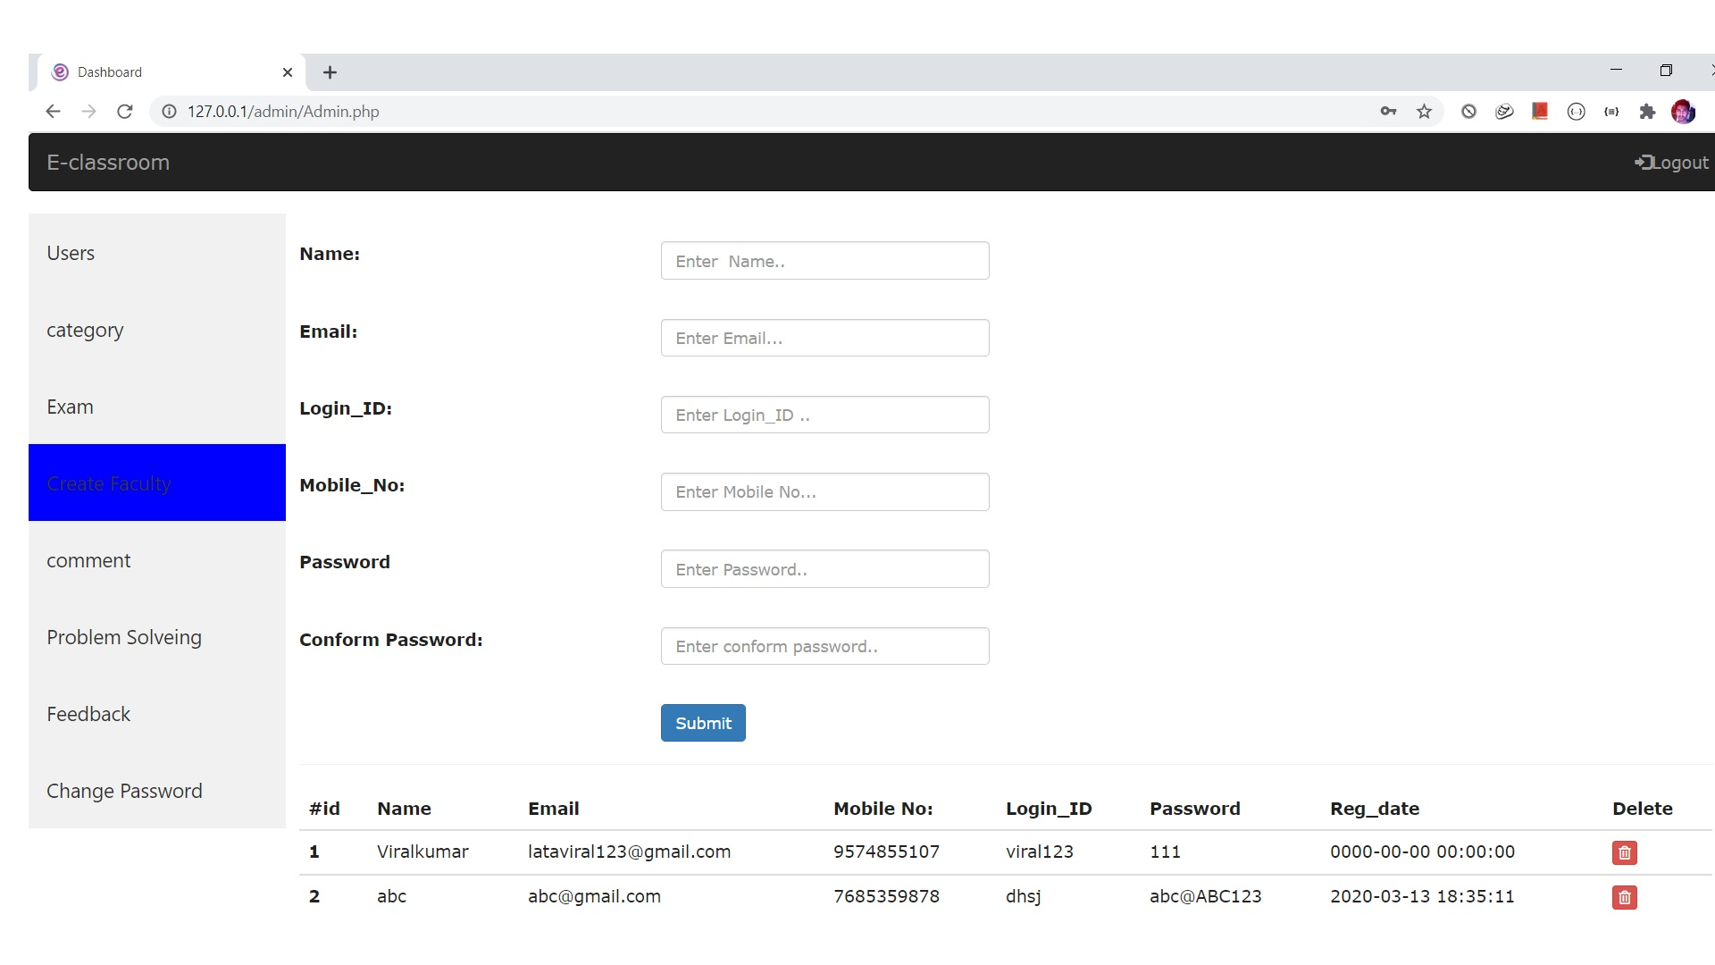

Slide 50
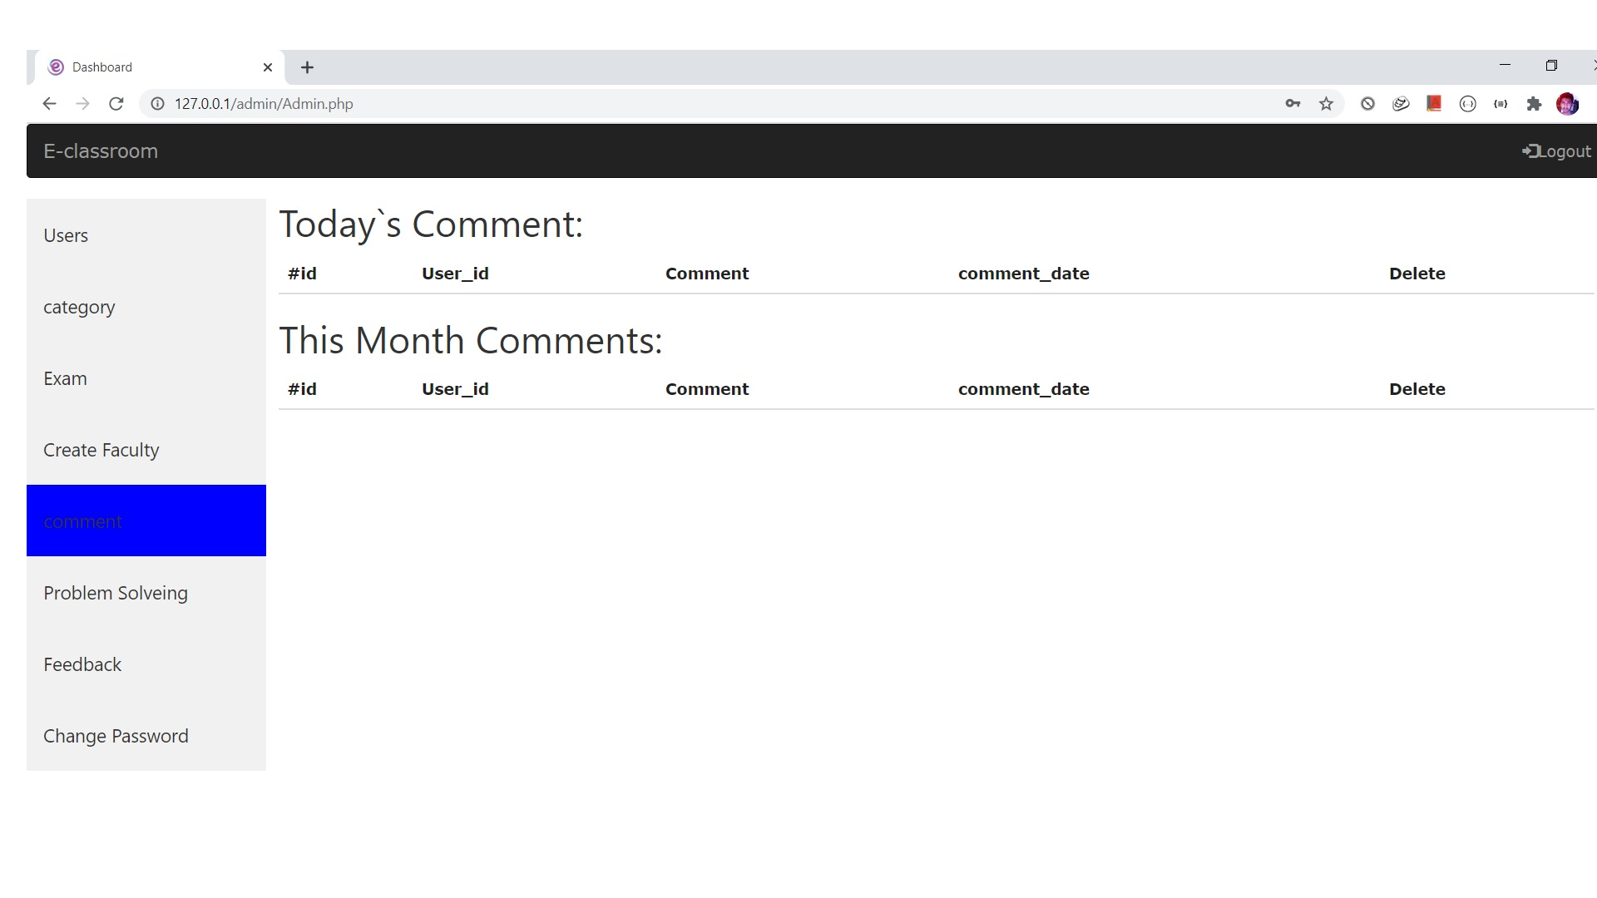

Slide 51
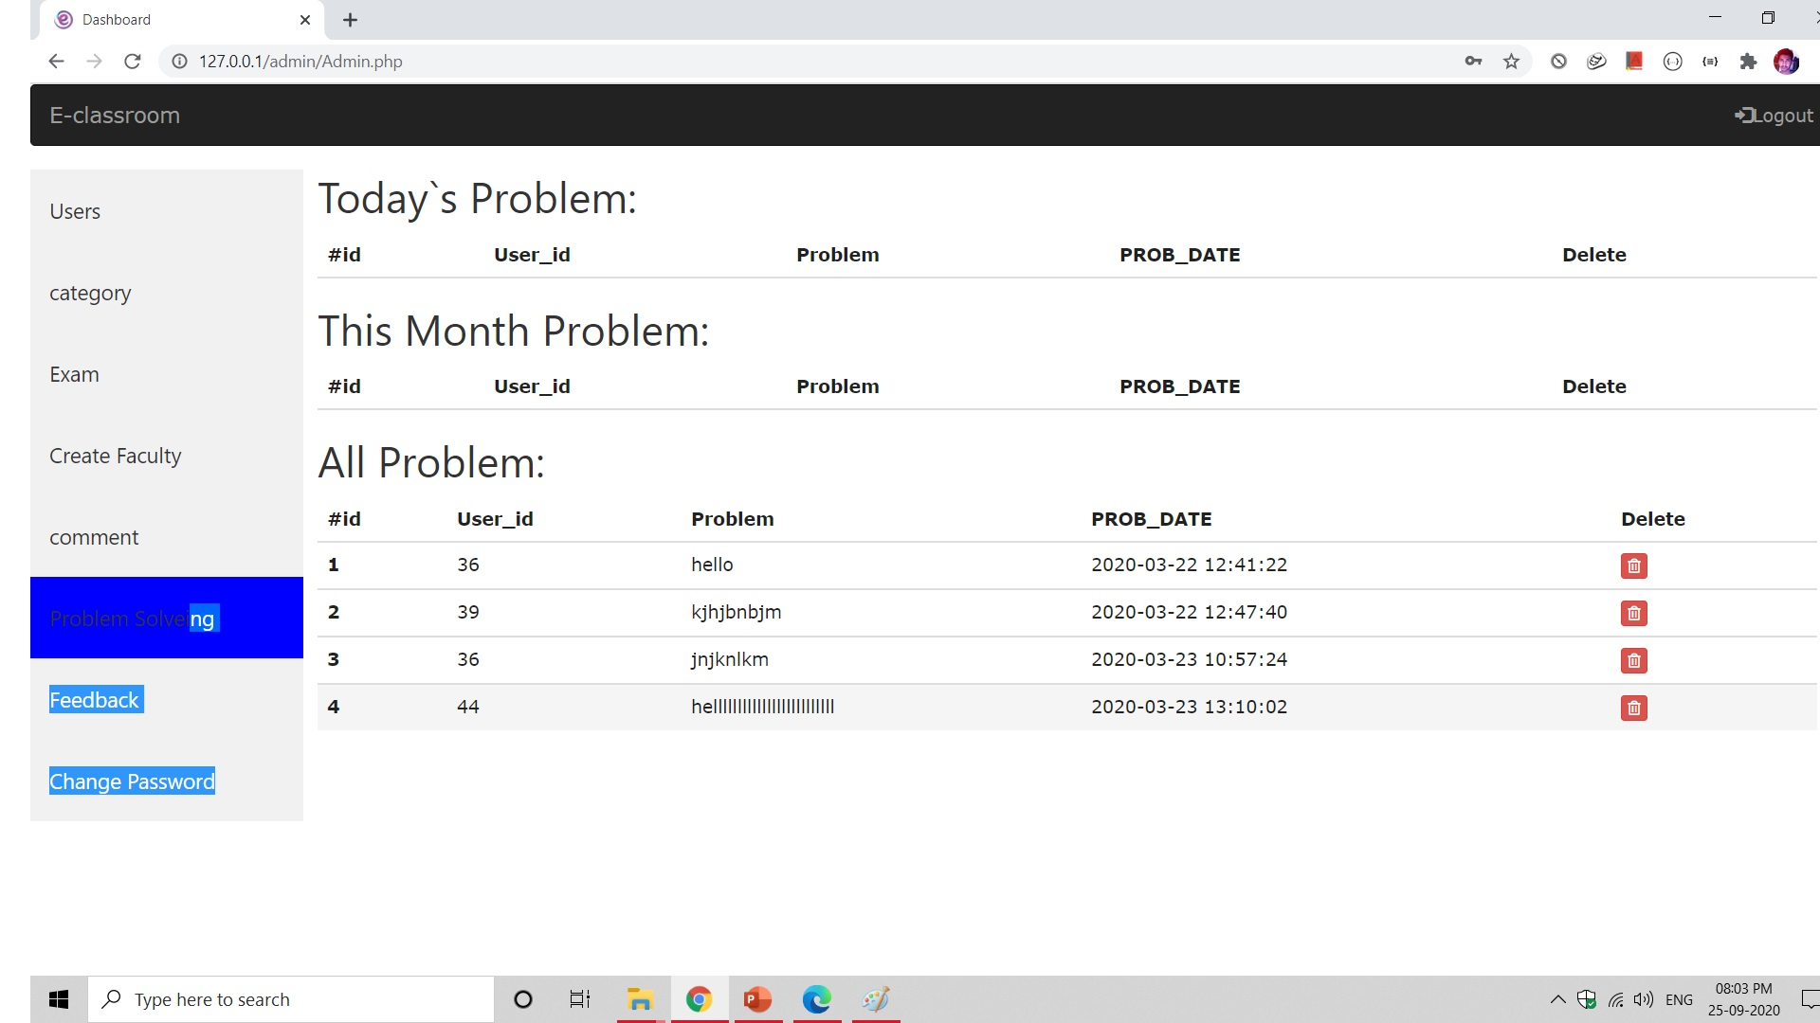

Slide 52
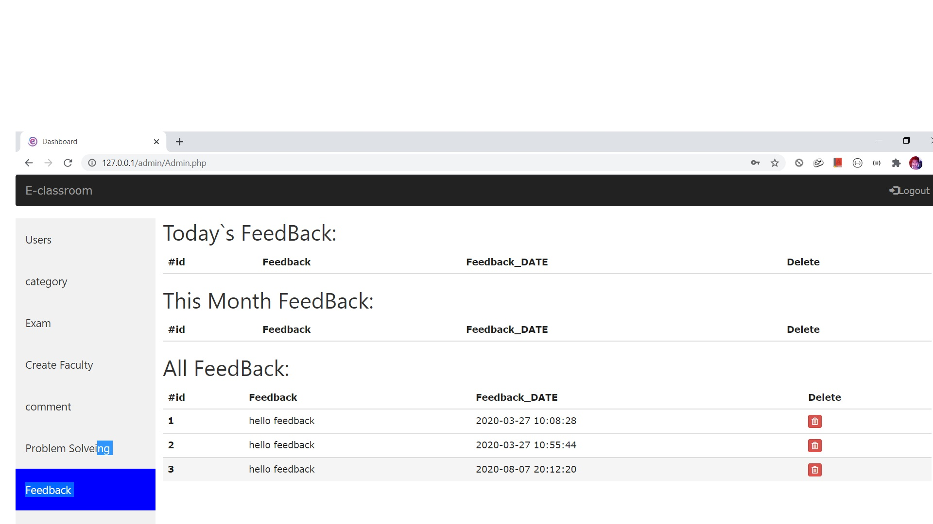

Slide 53
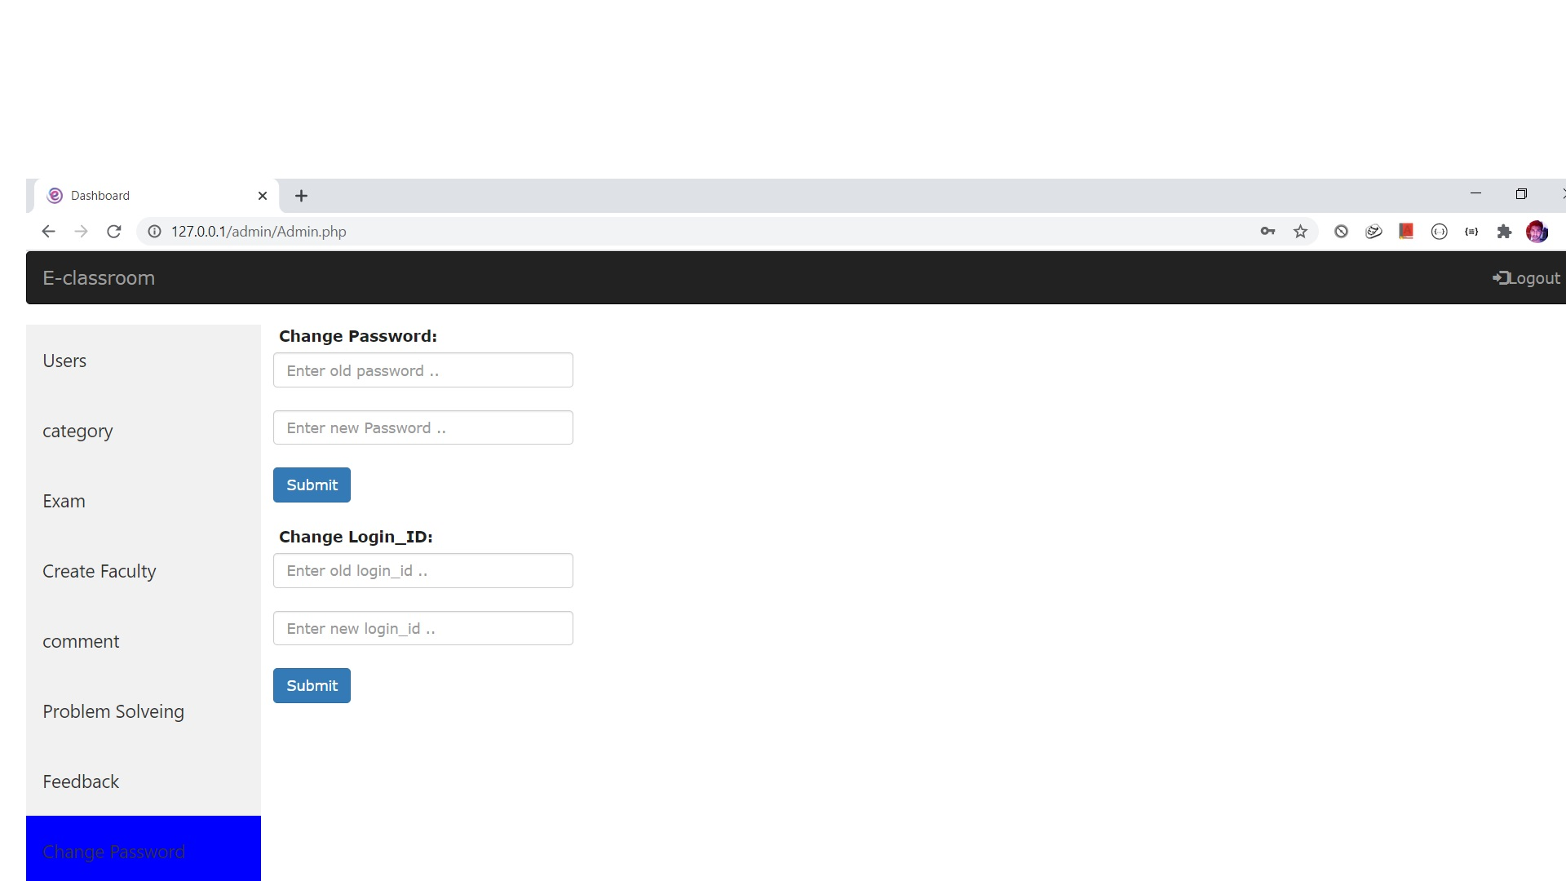

Slide 55
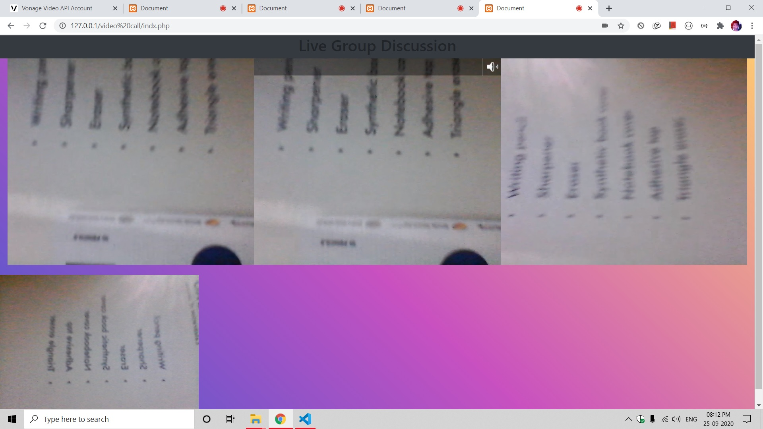

Slide 56
Thank you

